Slide 1
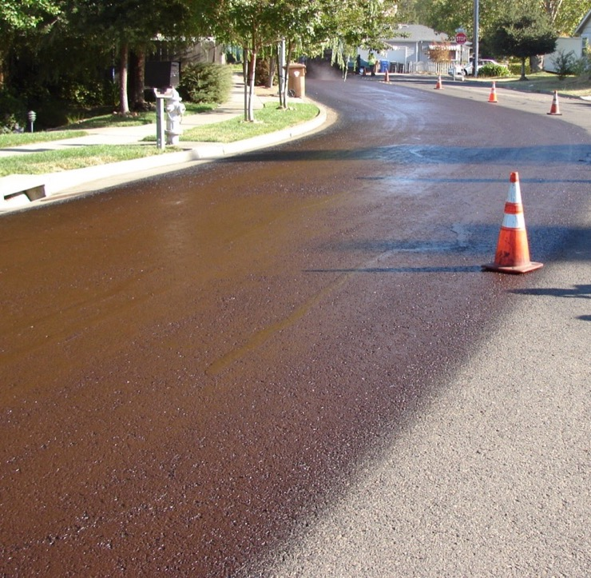


Fog Seal
AASHTO Construction Guide Specification 410
Notes:
TSP2 Emulsion Task Force – Fog Seal, Construction Guide Specification

Slide 2
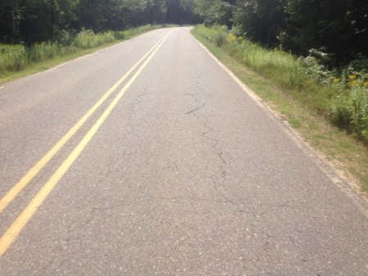
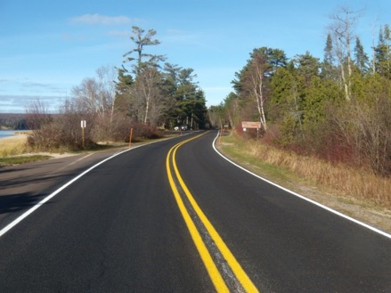
Construction Guide Spec
Description
This guide specification is intended to provide information to construct emulsified asphalt fog seals.
An emulsified asphalt fog seal is the application of emulsified asphalt, either diluted or undiluted, to a surface. It may be followed by a light application of blotter sand.
Fog Seals
  Extend the Service Life of asphalt surfaces
  Protect against water intrusion and oxidation
  Improve aggregate retention
Notes:
Introductory slide to explain what the training is about and what it covers.
Why would you want fog seal?? Explain.
Reducing the effects of oxidation and UV exposure through fog seal applications can greatly improve the life of an existing asphalt pavement. In addition, locking in the fine sands and aggregates before they start to ravel can have huge benefits as well.
Lastly, fog seal (aka flush coat) on a new chip seal can have the benefits of locking down any aggregate that may have slightly marginal seating. This will reduce user complaints re: windshields and bicyclists. In addition, fog seal will help improve the aesthetics of striping as it is set off against a darker surface.

Slide 3
Specification Development
Balloted through AASHTO COMP 5b
Construction guide 410
Provides information to construct an
emulsified asphalt fog seal
Separate guidance document on QA
Notes:
AASHTO “Committee on Pavement and Materials” (COMP) Technical Subcomittee 5B authorized the work.
Construction Guide is Specification 410

Slide 4

Sections Covered
  Materials
    Emulsion and blotter aggregate quality requirements
  Equipment
    Type, requirements and calibration
  Construction
    Weather, test strips, application rates, construction methods, traffic control
  Important Points/Critical Keys
    No Fly zones
  References
    To applicable AASHTO/ASTM standards.
Notes:
Sections Covered in this guide specification
*Materials
*Equipment
*Construction
*Important Points/Critical Keys
*References

Slide 5
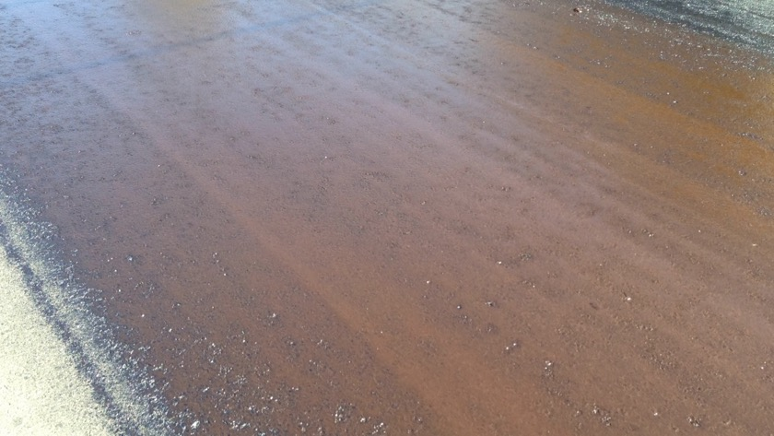
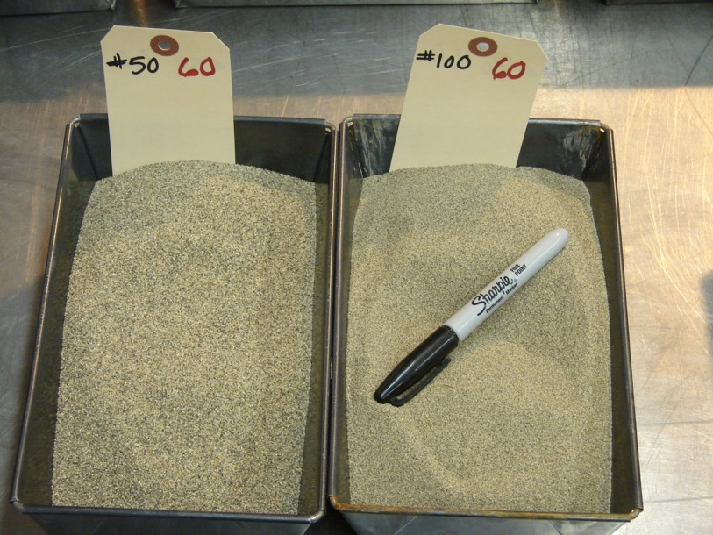
Materials
Emulsified Asphalt
  Meets AASHTO M 140 or M 208
  Table 2 covers typical application rates
Blotter Aggregate
  Table 1 Gradation
  Typical application rate 1-3 lbs/yd²
Notes:
Explain emulsified asphalt materials and agg gradations as per the tables shown.

Slide 6
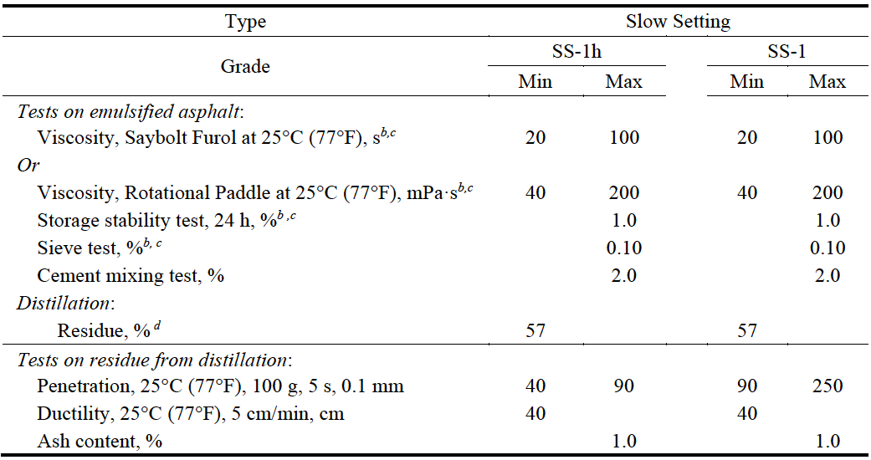
Emulsified Asphalt
Emulsion types and testing
  Variety of emulsions meeting either M140, M208, or M316
  Certification from the material supplier provided with each tanker showing test results
  QC Tests and frequency are outlined in the QA Guide for Chip Seals
Example of
M140 Test Criteria
Common emulsions for fog seal applications are slow setting emulsions
Notes:
Emulsified Asphalt
*The emulsified asphalt meets the requirements outlined in M140, 208 & 316
*Certification should be provided for each tanker
*QC tests and frequency outlined in guide should be followed
Fog seals emulsions are most typically slow setting without polymer. However certain circumstances such as open-graded surface mixes or fog/flush coats over new chip seals may require use of other types of emulsions.
See Material MP XX-2 for further guidance.

Slide 7

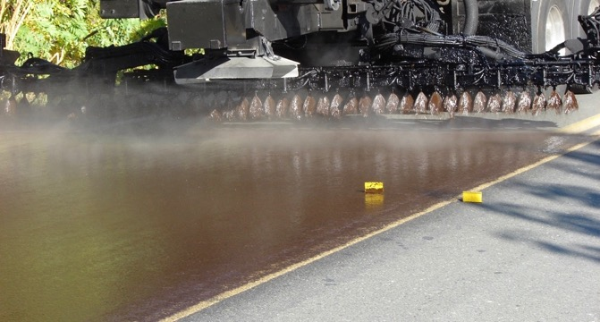
Keys to Success
Emulsified asphalt quality specs met
AASHTO Standards M140 or M 208
Testing from the producer
Approved source list
Documentation of the
  Batch or Lot
  Tanker or Distributor
Notes:
Little more detail on testing, approved supplier lists (does it apply in this jurisdiction?)
Documentation/ certification by lot/batch/truck

Slide 8
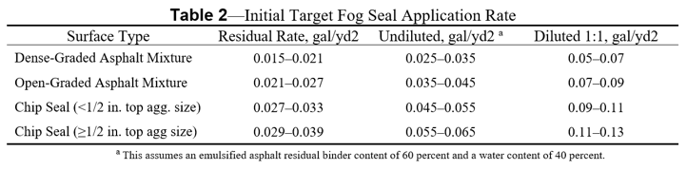
Design
Construction Guide Section 410.5.2
  Table 2 – Initial Target Rates
  Ring Test to confirm application rate
Notes:
Construction Guide Section 410.5.2
Focus on making sure friction exists before considering a fog seal. Open graded pavements, chip seals, slightly raveled pavements are all good candidates.
Dense graded tight pavements, flushed surfaces, slurry/micro surfaced pavements probably not good candidates.
Want to ensure that friction is not reduced to much lower levels or pavement is not flooded.
Tables 1 and 2
Ring test See next slide to point out differences.

Slide 9

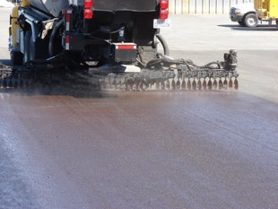
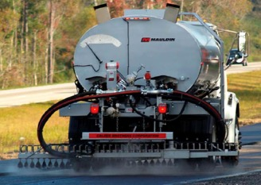
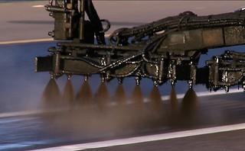
Keys to Success
Conduct test strip or ring test
Verify that shot rate will give desired results but does not cause significant reduction in surface texture
Don’t skip this step!

Slide 10
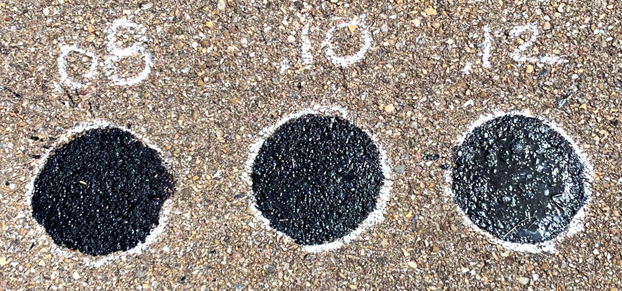
.08 gal/yd² Good coverage, surface texture maintained. Acceptable rate
.10 gal/yd² Good coverage, starting to fill in some of the void structure. Desired rate
.12 gal/yd². Too much material on surface. Voids completely filled Over application

Slide 11
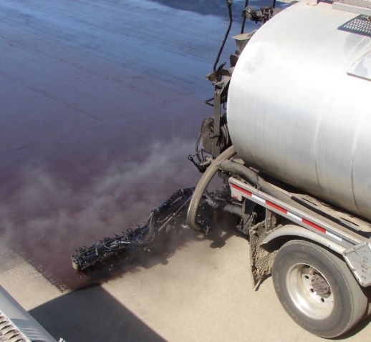
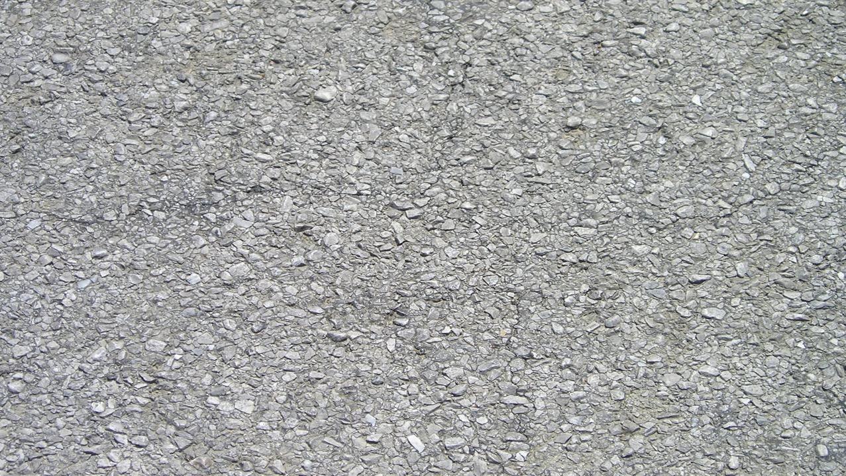
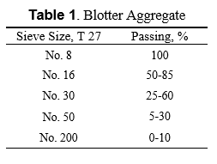
Aggregate
Construction Guide Specification Section 410.4.2
  Table 1
  Quality Control
Outlined in the QA Guide
Notes:
Aggregate
*Please review Construction Guide Section 410.4.2 Tables 1
*Certification review prior to construction & source change
*QC outlined in the QA guide – THERE IS NO QA GUIDE FOR FOG SEALS. SWD

Slide 12
Keys to Success
Aggregate gradation and quality specs met
AASHTO Standards T 27
QA or QC Testing
Approved source
This aggregate is only used if
  Excess emulsion is applied
  Area needs to be open to traffic before the emulsion is set
  Required by contract

Slide 13
KNOWLEDGE CHECK
The most common type of diluted asphalt emulsion used for fog seals is?
  a) Slow Setting
  b) Polymer Modified
  c) Rapid Setting
  d) Mayonnaise a lot of different emulsions
A: Slow Setting
Notes:
D) Man-they-is a lot of different emulsions. (slight southern drawl for effect).
Answer: Slow Setting (Cationic or Anionic)

Slide 14


Keys to Success
Weather requirements are met
Ensure that the emulsion will break and harden to the level needed
Temperatures shall be 60°F and rising
Ambient or pavement temperatures requirements
Dry surface
Wind less that 10 mph
Application of the fog seal shall be only during daylight hours
Suspend fog seal operations when rain is expected
Notes:
Section 410.5.1
Other requirements to discuss. No temps below 40 F for 24 hrs after application
Complete at least 2 hrs before sunset.
If operation has to be done with winds above 10 mph, skirt can be added to the distributor bar to protect spray pattern

Slide 15
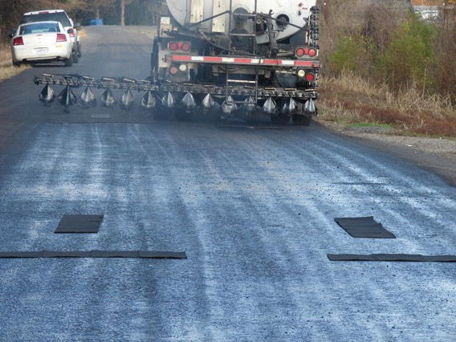

Keys to Success
Perform calibration
Ensure that the emulsion is applied at the correct rate
Visually Determine
Correct nozzle size
Nozzle are aligned
Spray bar height set for desired coverage (single, double, triple)
Don’t skip these steps!
Notes:
Distributor Calibration importance
Nozzle angles - ALL should be the same (except maybe the outside 2 nozzles for the meet line or fog line)
Bar height
Overlap
Good pattern, Bad pattern, calibration pads on ground.
SPLIT INTO TWO SLIDES. PICS>

Slide 16
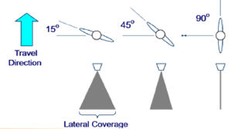
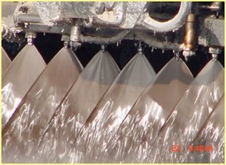
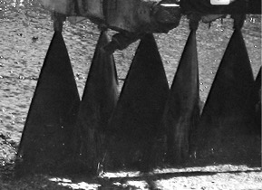
Nozzle alignment and adjustments
Notes:
Discuss types of overlap/ height above pavement, nozzle angles, using diagrams.
Bottom left. Good spray pattern, even consistent, etc..
Bottom right, uneven, not aligned. If you see this STOP THE TRUCK and have them fix their nozzles. Not acceptable.
Note that the very outside two nozzles on both sides of the bar may be different to create a “knife edge” and straight line.

Slide 17
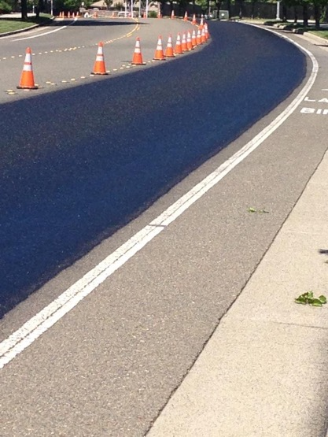

Reminder of Important Points!
Ensure the fog seal application does not cause a significant surface friction reduction
Daily application rates checks
Traffic may be allowed on the fog seal after the emulsified asphalt has cured or, if used, after aggregate has been applied
Blotter aggregate can be used to absorb excess emulsified asphalt.
Notes:
For open graded/gap graded pavements additional void structure in the surface typically means a higher application
Ring test and test strip is very important to achieve good results
Check application rates daily to ensure
Open to traffic when ready to be driven on without tracking material

Slide 18

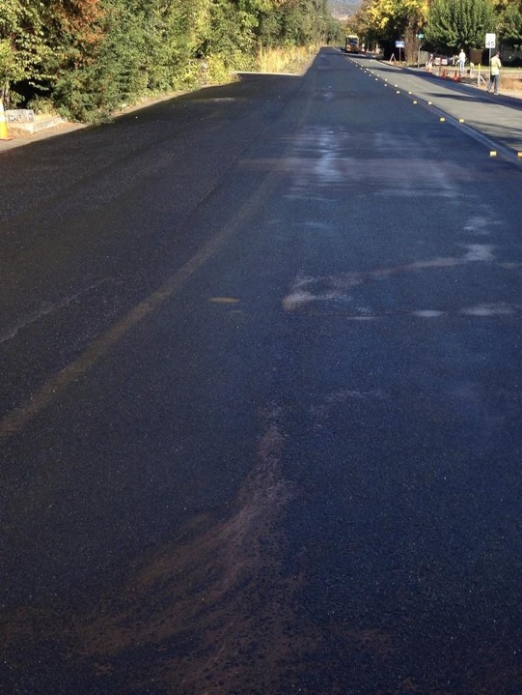

Fog Seal – Keys to Success
Do not allow traffic until completely set
Emulsion to be fully set
or Use blotter sand to protect fog seal and vehicles

Slide 19
KNOWLEDGE CHECK
Spray nozzles should be aligned and maintained at what angle?
  a) 90 Degrees
  b) 180 Degrees
  c) 15-30 Degrees
  d) Celsius or Fahrenheit is acceptable
C: 15-30 Degrees
Notes:
C) 15- 30 degrees

Slide 20
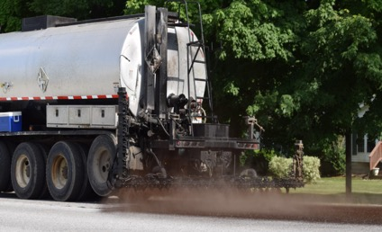
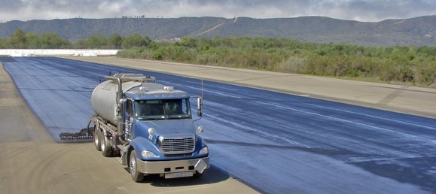
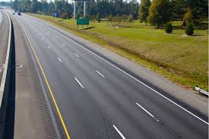

Keys to Success
Incorporate a QA/QC program into spec

Slide 21
Quality Control
Personnel –
  QC Manager – responsible for development and implementation of the Quality Control Plan
  QC Technicians – responsible for sampling and executing QCP
  Certified Crew Members
Testing Facilities and Equipment
  Lab for testing of both emulsions and aggregates
Notes:
You get what you test/inspect NOT what you EXPECT
Stress importance of testing

Slide 22
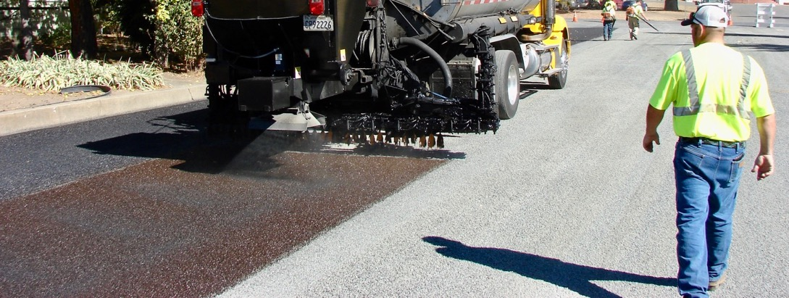

Keys to Success
Trained (certified) inspector & contractor staff
Nationally recognized certification
Agency certification
In-house training
Successful projects have well trained staff
Notes:
Multiple ways to get people trained.

Slide 23


Fog Seal – Keys to Success
Materials specifications met
Conduct test strip or ring test
Weather requirements are met
Perform calibrations
Do not allow traffic until completely set
Incorporate a QA/QC program into spec
Trained (certified) inspector & contractor staff
Notes:
SUMMARY

Slide 24
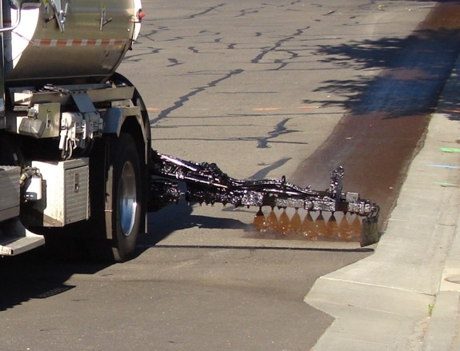
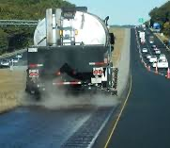
Measurement
Guide Specification recommends
  Emulsion by gallon
  Aggregate by square yard
  As an alternate the aggregate could be measured by weight

Slide 25


Payment Options
  Materials in unit costs
  Completed square yards

Slide 26
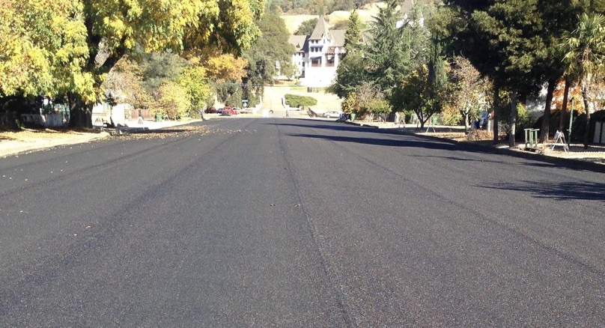
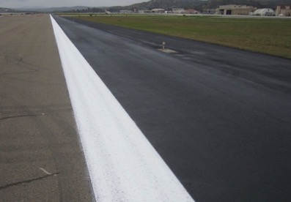
Questions

Slide 27
Reference Specifications
AASHTO
  Section 410 – Construction Guide Specification for Emulsified Asphalt Fog Seal
  M 140 – Emulsified Asphalt
  M 208 – Cationic Emulsified Asphalt
  M 316 – Polymer-modified Cationic Emulsified Asphalt
  T 27 – Sieve Analysis of Fine and Course Aggregates
  T 304 – Standard Method of Test for Determining the Uncompacted Void Contend of Fine Aggregate
ASTM
  D5624, Standard Practice for Determining the Transverse-Aggregate Spread Rate for Surface Treatment Applications

Slide 28
Other References
Martin, R. S., Jr.; "Chip Seal Practice", Proceedings of the 26th Paving and Transportation Conference, Department of Civil Engineering, University of New Mexico, Albuquerque, New Mexico, January 1989.
Shuler, S.; High Traffic Chip-Seal Construction: The Tulsa Test Road. In Transportation Research Record No. 1300, National Academy of Sciences, Washington, DC, 1991, pp. 116–124.
Shuler, S., A. Epps-Martin, T. Lord, and D. Hoyt; National Cooperative Highway Research Program Report 680: Manual for Emulsion-Based Chip Seals for Pavement Preservation. National Cooperative Highway Research Program, Transportation Research Board, Washington, DC, 2011.

Slide 30
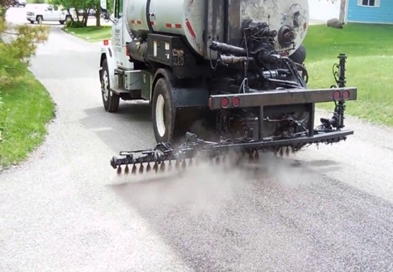
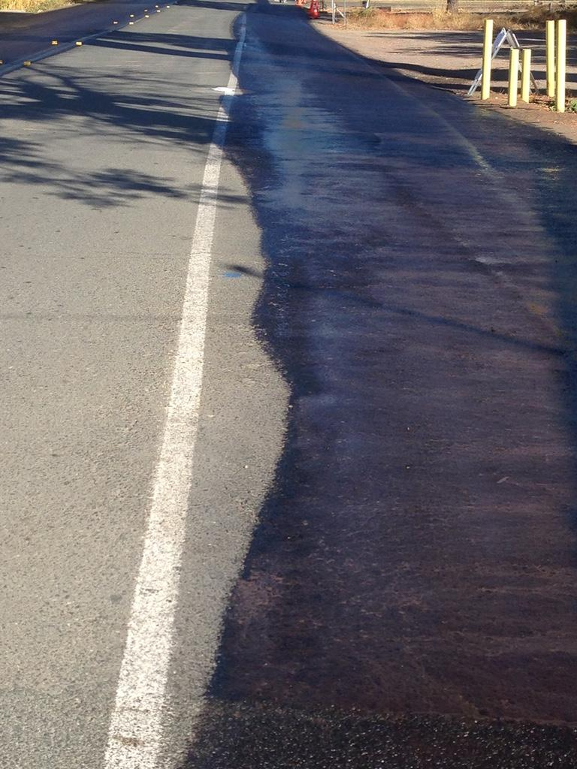
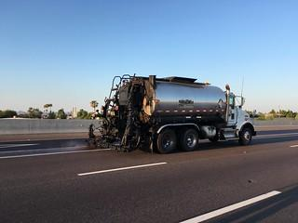

Slide 31








Resources
This is the suggested color palette for the template.
This image was downloaded from a free use graphics website.
This image was downloaded from a free use graphics website.
This image was made by Travis and is free to use.
These icons were downloaded from a free use graphics website and slightly altered.

