Slide 1

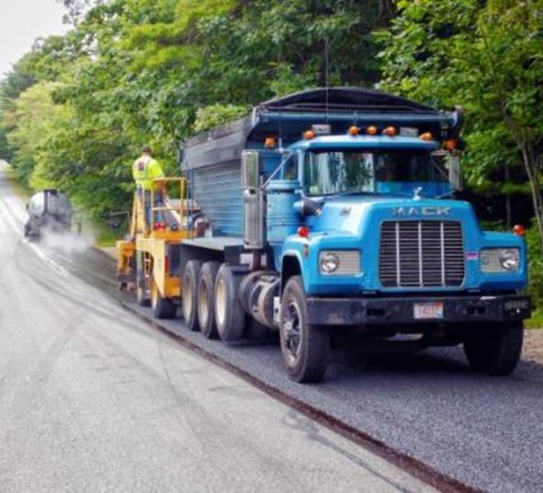
Construction Guide Specification
Emulsified Asphalt
Chip Seal
Notes:
TSP2 Emulsion Task Force – Emulsified Asphalt Chip Seal, Construction Guide Specification presentation
Introduce yourself
I am here today to talk to you about some work the TSP2 Emulsion Task Force has been involved in on Construction Guides Specifications for some pavement preservation applications. Specifically, here, I am going to be discussing the Construction Guide for Emulsified Asphalt Chip seal.

Slide 2
Construction Guide Specification for
Emulsified Asphalt Chip Seal
Section 406(replace with actual standard designation)
Balloted through AASHTO COMP 5b - Covers construction of single application chip seals
Separate guidance document on QA
Notes:
This construction guide was developed by the Expert Task Force and balloted through AASHTO COMP 5B.
Currently, it is under the designation of Section 406, but should receive a standard designation before publication in July 2021.
The standard covers the single application of a chip seal. In addition to the new construction guides, which also exist for microsurfacing and fog seal.
There are separate QA documents, that are also being published under 5B.

Slide 3
Sections Covered
  Materials
    Emulsion and aggregate quality requirements
  Design
    PP 82
  Equipment
    Type, requirements and calibration
  Construction
    Weather, test strips, application rates, construction methods, traffic control
  Important Points/Critical Keys
    No Fly zones
  References
    Throughout the presentation - AASHTO(noted as P, M, R and T) and ASTM
Notes:
In this presentation, the goal is to give a general overview on what is covered in the construction guide.
You can see the agenda here: Materials, Design, Equipment, Construction and References.
The Critical Keys to success are scattered throughout the presentation. We are referring to these as ‘no fly zones” in that you really have to pay attention to these and get them correct to ensure a good project.
Important points to understand are summarized at the end of the presentation

Slide 4
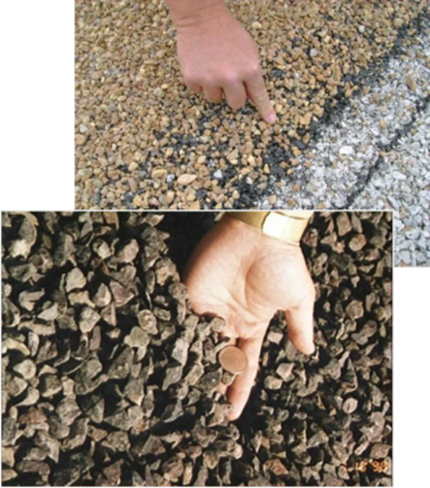

Materials
Notes:
So, lets get right into it. In this first section, we are going to cover materials, asphalt emulsion quality sampling and testing along with aggregate quality sampling and testing.

Slide 5
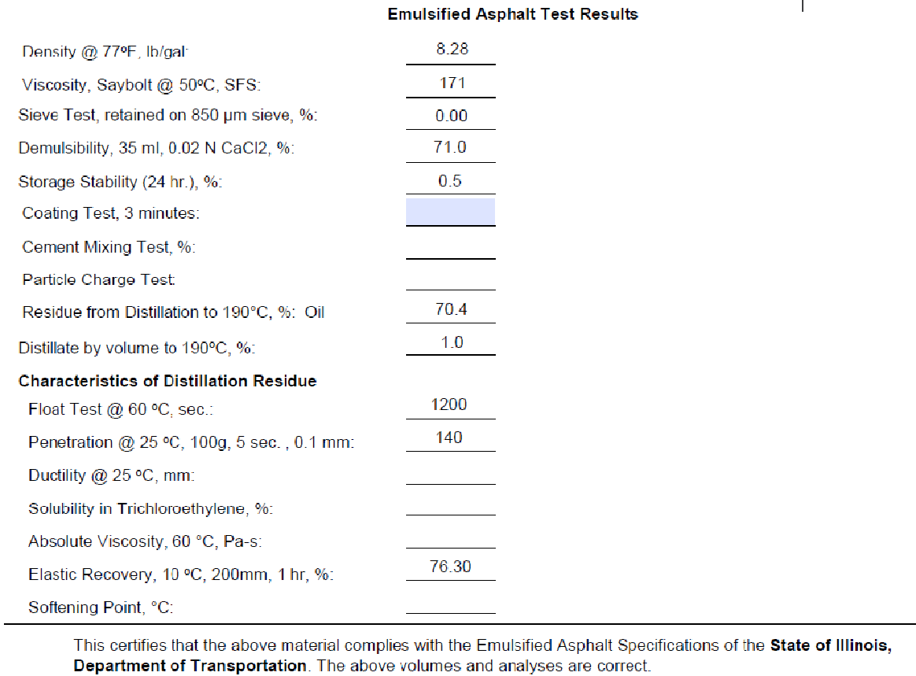
Emulsified Asphalt
  Rapid Setting type meeting M140, M208 or M316
  Certification from the material supplier should be provided for each tanker
  QC Tests and frequency are outlined in the QA Guide for Chip Seals
Sample Certification
Notes:
Starting with the emulsified asphalt, the AASHTO specifications for these materials are M140 which covers anionic emulsions, M208 which covers cationic emulsions and M316 which covers both anionic and cationic polymer modified emulsions.
In all of these different types of emulsions represented in the standards, preference is given to the rapid setting type.
Certifications should be provided for every tanker load of material used in the job. We have an example of a certification here. Samples should also be collected from the job site for additional testing. Depending on the test, this can be every 200-500 tons. Those QC tests and frequencies are outlined in the QA Guide for Chip Seals.

Slide 6
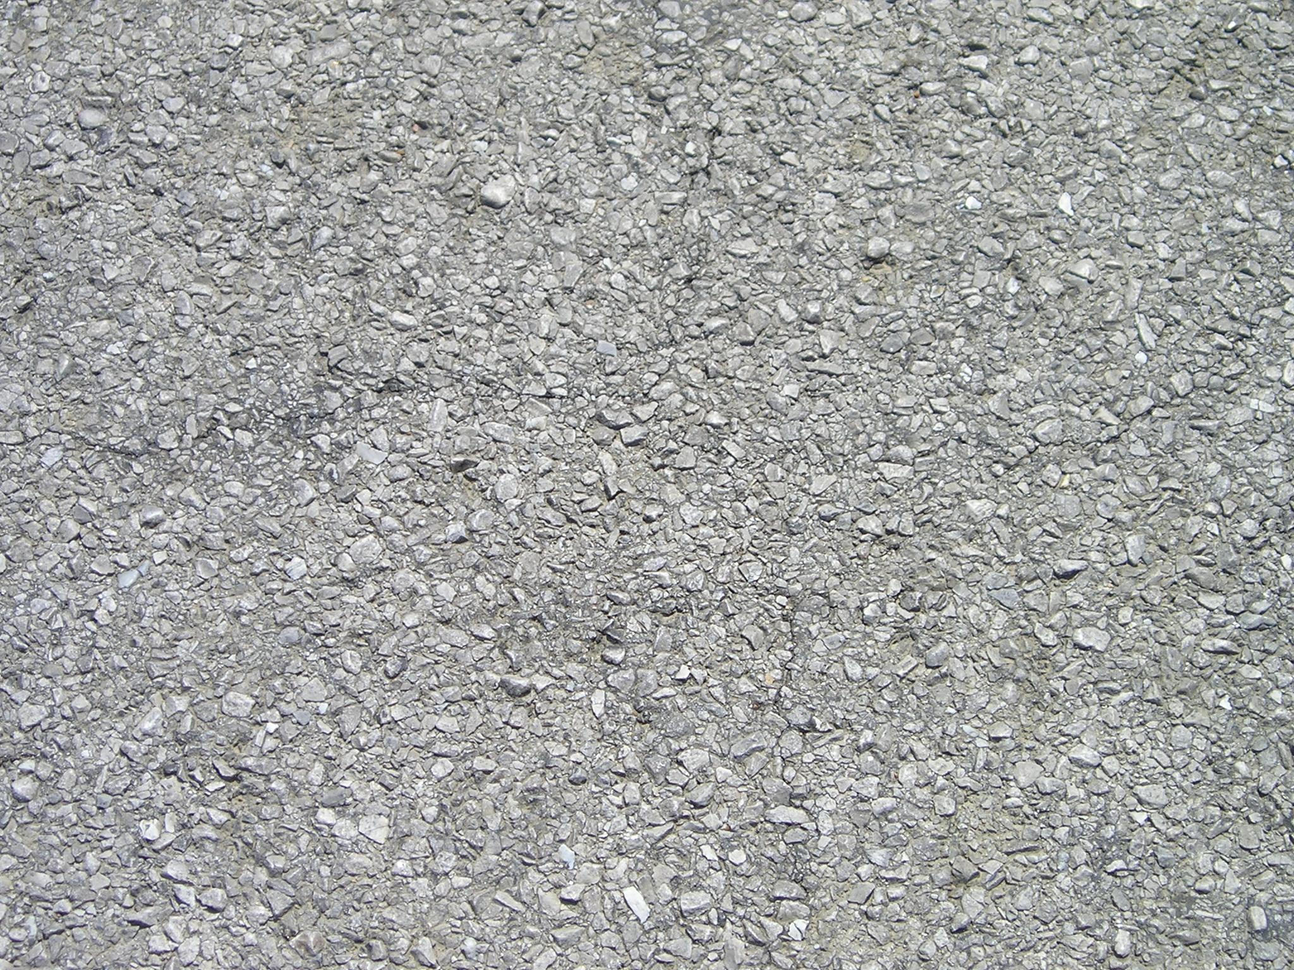
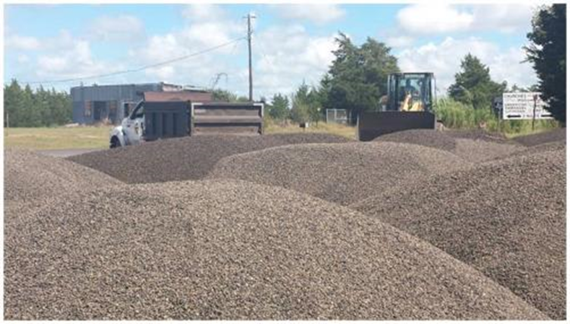
Aggregate
MP 27 - Section 6.1 Tables 1 and 2
Certification - Prior to construction and source change
Quality Control - Outlined in the QA Guide, crushed, single sized
Preferred stockpile height
Notes:
Moving onto aggregate, In AASHTO MP 27 section 6.1, Tables 1 and 2 for specification for aggregate used in chip seals.
Single sized aggregate is preferred to graded aggregate.
There are less voids in graded aggregate and less room to fit the emulsified asphalt.
Other quality considerations are covered in the QA document for Chip seals.
Certifications should be provided prior to construction and whenever there is a source change.
When taking samples of stockpile, the stockpile height should be noted. Taller stockpiles can lead to greater segregation. The best technique to minimize this is dropping truck piles next to each other to minimize that high cone heap and keeping the larger particles from rolling.

Slide 7

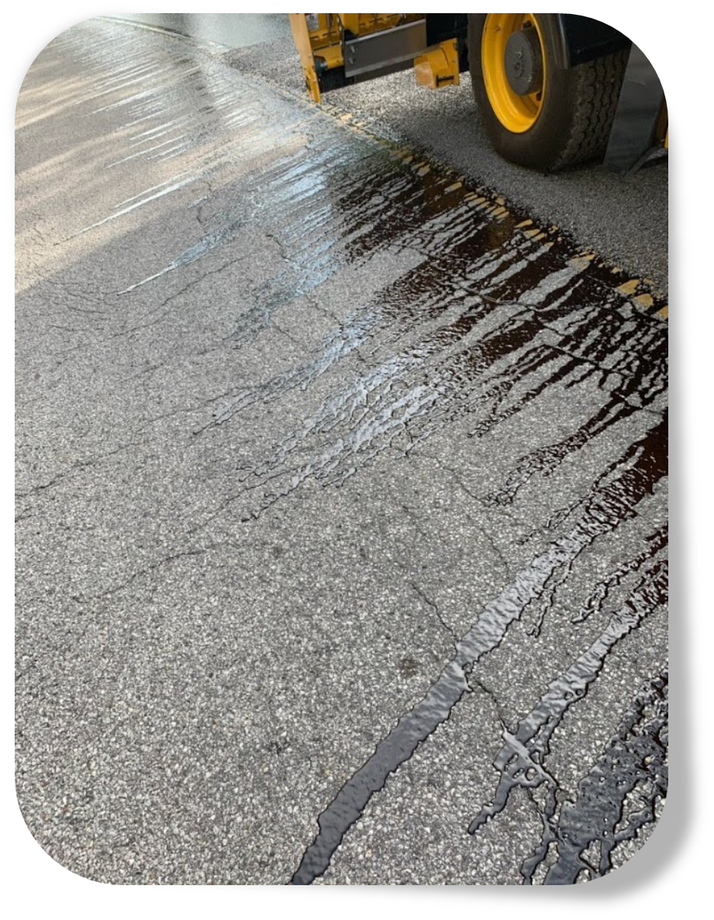
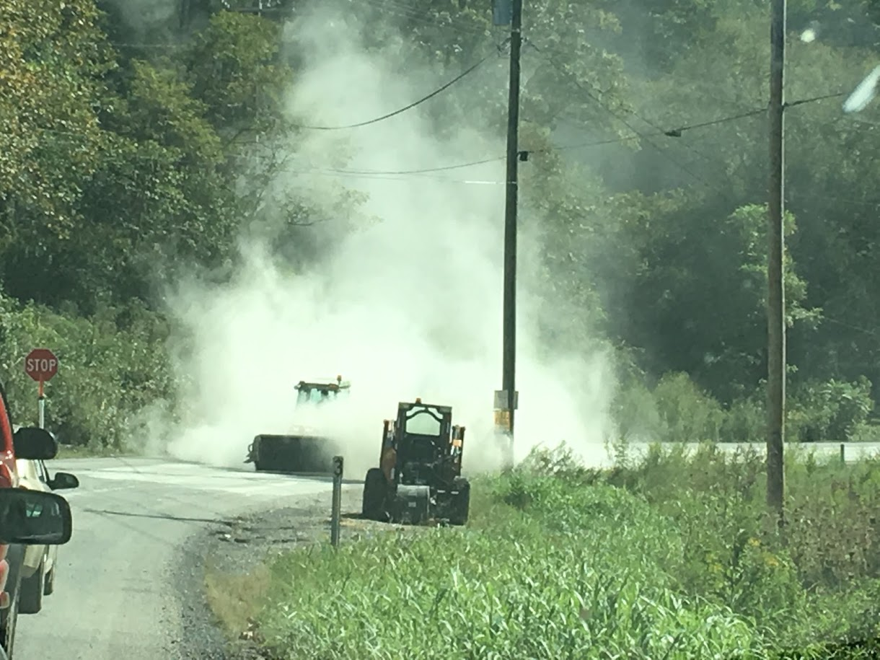
Critical Keys to Success
Aggregate and asphalt emulsion quality specs met
Notes:
The first Critical Key to Success. Aggregate and Asphalt emulsion quality specs have to be met. You have to monitor the certificates of analyses. You have to sample and test the aggregate and emulsion. Just a couple of things that can happen on the roadway when those specs are not met:
Low viscosity emulsion can flow off the existing pavement before the aggregate is placed.
High flakiness index of the aggregate can lead to bleeding due to the aggregate not laying on it’s flattest side.
High quantities of No. 200 dust can lead to less chip retention.
Aggregate too wet can lead to longer cure times.
Checking your certificates coupled with sampling and testing can help to ensure you have the proper materials.

Slide 8
KNOWLEDEGE CHECK
The following should be included with each emulsified asphalt sample?
  a) Supplier name and location
  b) Batch number
  c) Emulsified asphalt grade
  d) Supplier Tank number
  e) All of the above
Notes:
Time for a knowledge check. Answer E, all of the above.

Slide 9
Mix Design
Emulsified asphalt and aggregate
spread rates should be determined by
design like PP82 or McLeod method
found in Minnesota Seal Coat Handbook.
Emulsified asphalt should be
applied within +/-5% of design.
Aggregate should be placed at
design rate with minor adjustments .
Notes:
Now for our next topic, mix Designs. The quantity, or application rate of emulsified asphalt and aggregate chips used in chip seal construction plays a large role in determining the success of the treatment.
The design should be conducted per PP82 or the McLeod method. With the design complete, emulsion should be applied within +/- 5% of design and aggregate should be placed at design rate with minor adjustments.
A couple of examples for sticking to the design :
When too much emulsified asphalt is used, the aggregate becomes buried and flushing occurs.
If too little emulsified asphalt is used, the aggregate dislodges under traffic and windshield damage occurs.

Slide 10
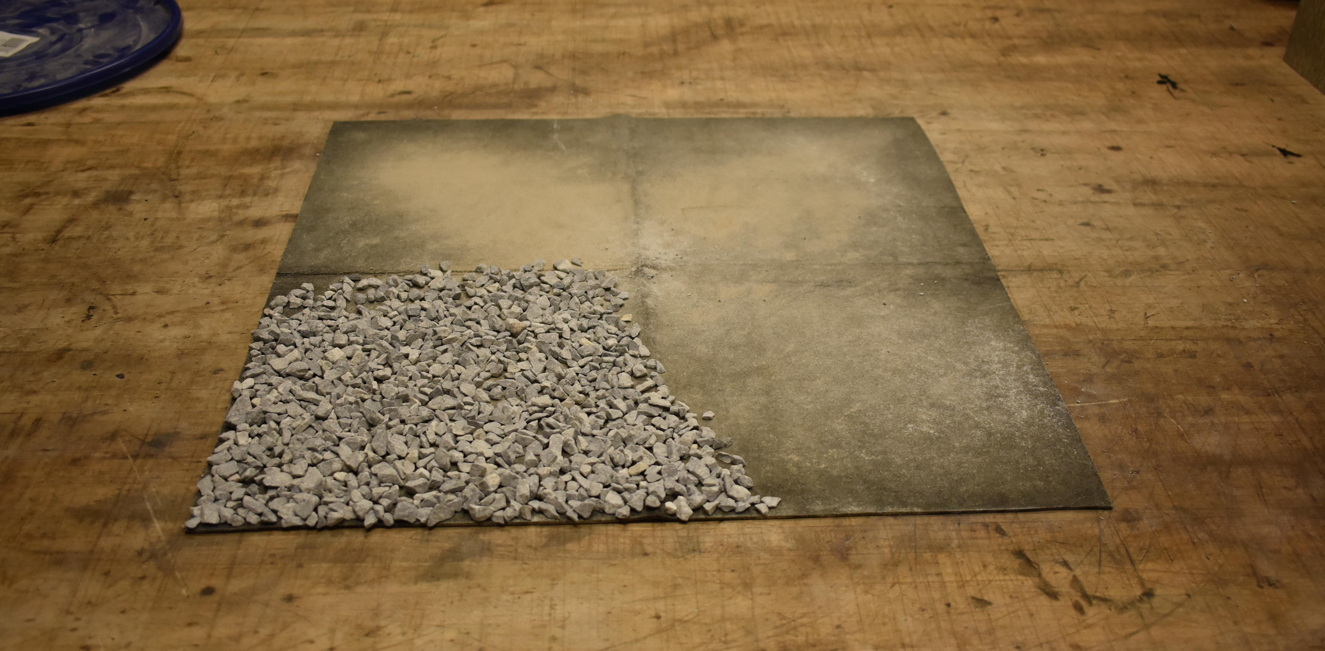
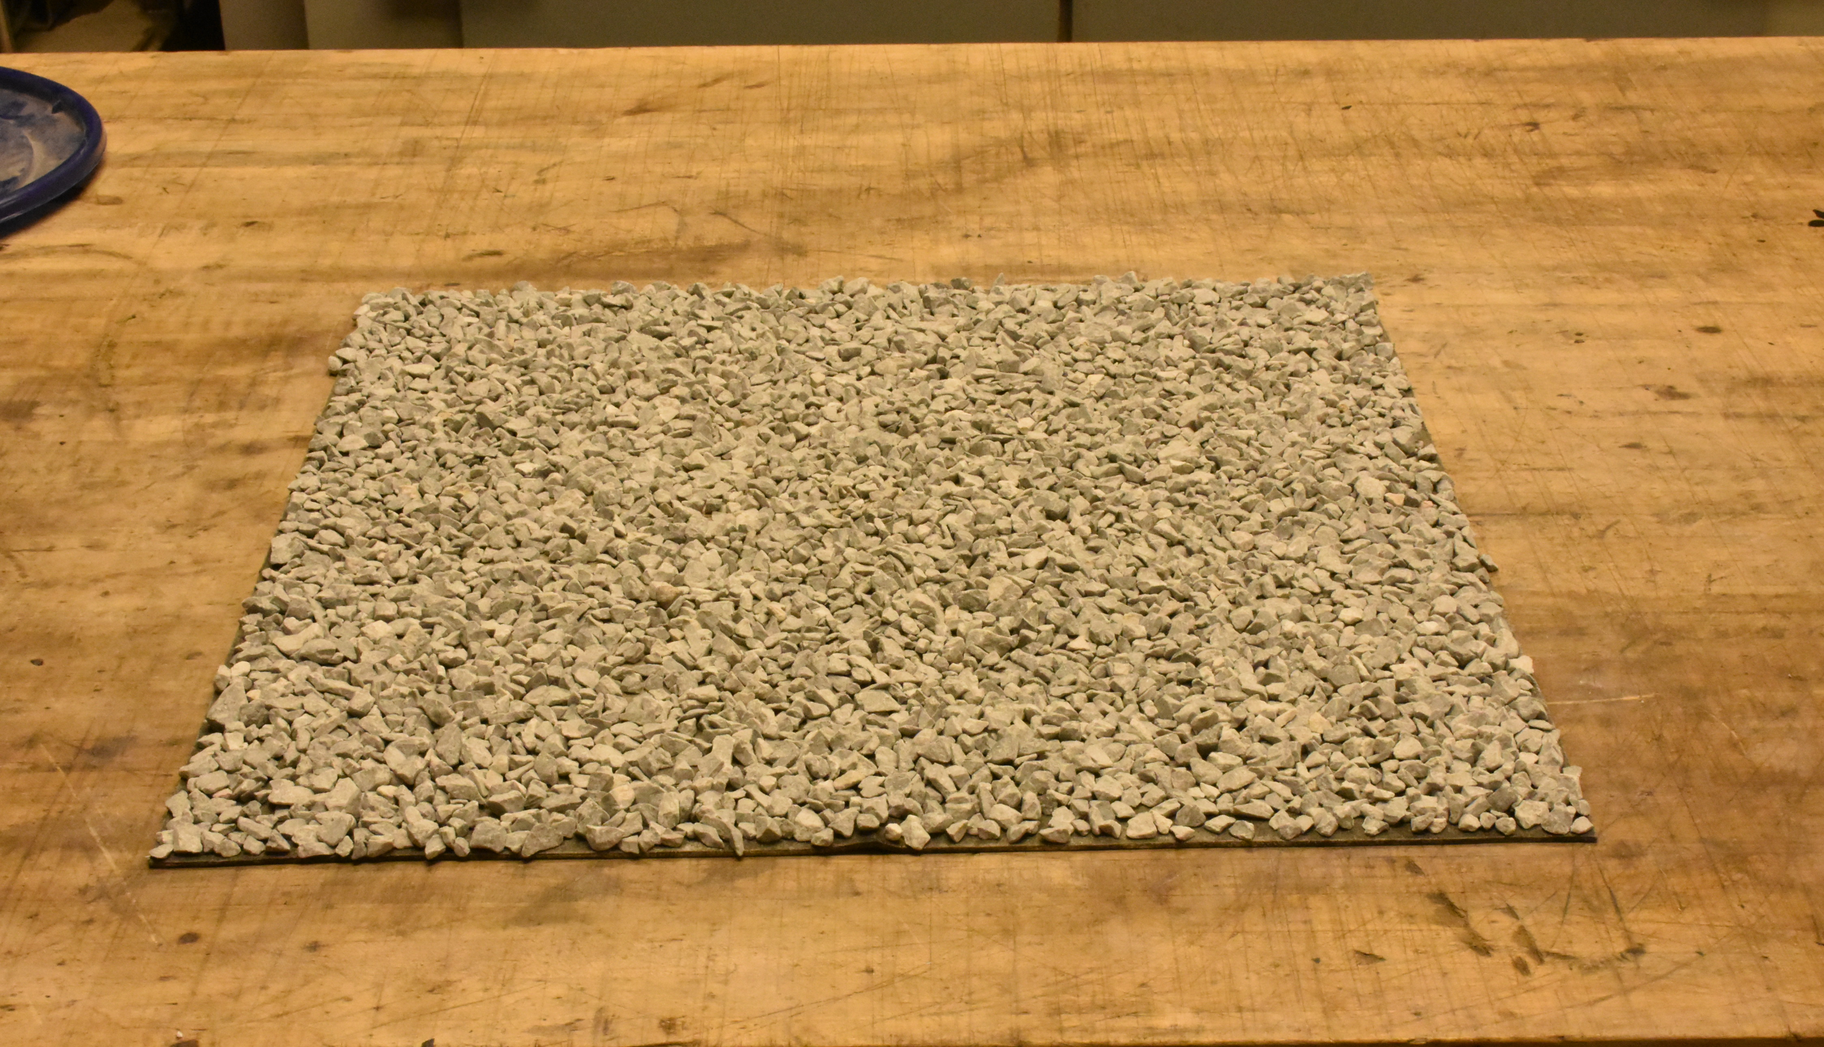
Mix Design – Aggregate Application
Assumes one layer of asphalt
emulsion and one layer of aggregate.
Aggregate is spread on a board
measuring 3 feet by 1 ½ feet.
Weight of one layer of aggregate,
is determined, multiplied by 2, and
this becomes the design rate.
Notes:
Digging into AASHTO PP-82-16, this method assumes the completed chip seal will consist of one layer of emulsified asphalt(eventually the residual asphalt) and one layer of aggregate.
The layer thickness is one layer thick.
The aggregate application rate is determined in the laboratory by spreading the aggregate chips to be used on the project on a board measuring 3 feet by 1.5 feet.
The weight of the layer of aggregate one stone thing on the board is determined, multiplied by 2 and this becomes the design application rate of the aggregate.
Aggregate adjustments should be made to ensure that some emulsion can be seen through the chips.

Slide 11
Mix Design – Emulsion Application
A = {5.61 e [1.33Q/W][1-(W/(62.4G))] T + V}/ R
Where the terms are as follows,
A = Emulsified asphalt application rate , gallons per square yard
e = Percent embedment depth of aggregate , expressed as a decimal
Q = Quantity of aggregate from Board Test, pounds per square yard
W = Dry loose unit weight of aggregate , pounds per cubic foot (see T 19M/T 19, Section 12 on shoveling)
G = Dry Bulk Specific gravity of aggregate (see T 84 and T 85)
T = Traffic Correction Factor, Table 2
V = Pavement Surface Correction Factor, Table 3
R = Emulsified asphalt residue, expressed as a decimal
Mix Design Methods:
Kearby – PP82
McLeod-MNDOT
There are a lot of terms in this equation and it looks complicated. It is not. The only laboratory measurements needed are Q, W and G.
Notes:
Emulsion application rate can be determined by the McLeod method or modified Kearby method. PP82-16 is based on the Kearby Method.
The equation shown will give the estimated emulsified asphalt design rate. There are a lot of terms in this equation and it looks complicated. It is not.
The only laboratory measurements needed are Q, Q and G. This design rate is the best estimate of how much emulsified asphalt should be applied prior to actually doing it.
However, this may change during construction if the appearance of the application is not acceptable.
Regardless of both design estimations, care should be taken in the field to ensure that the chip seal has the salt and pepper appearance.

Slide 12
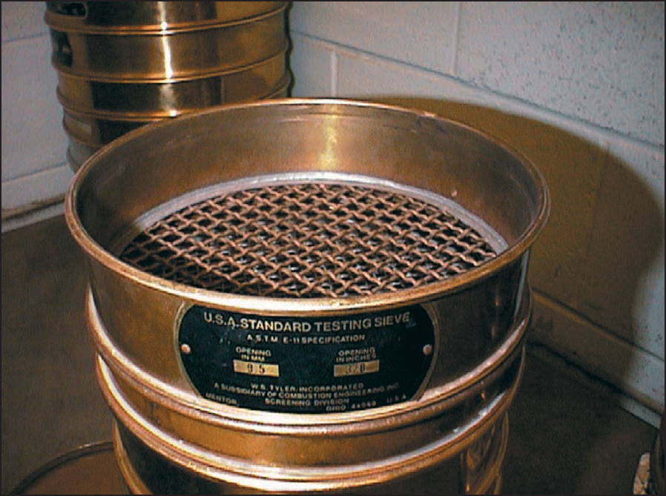
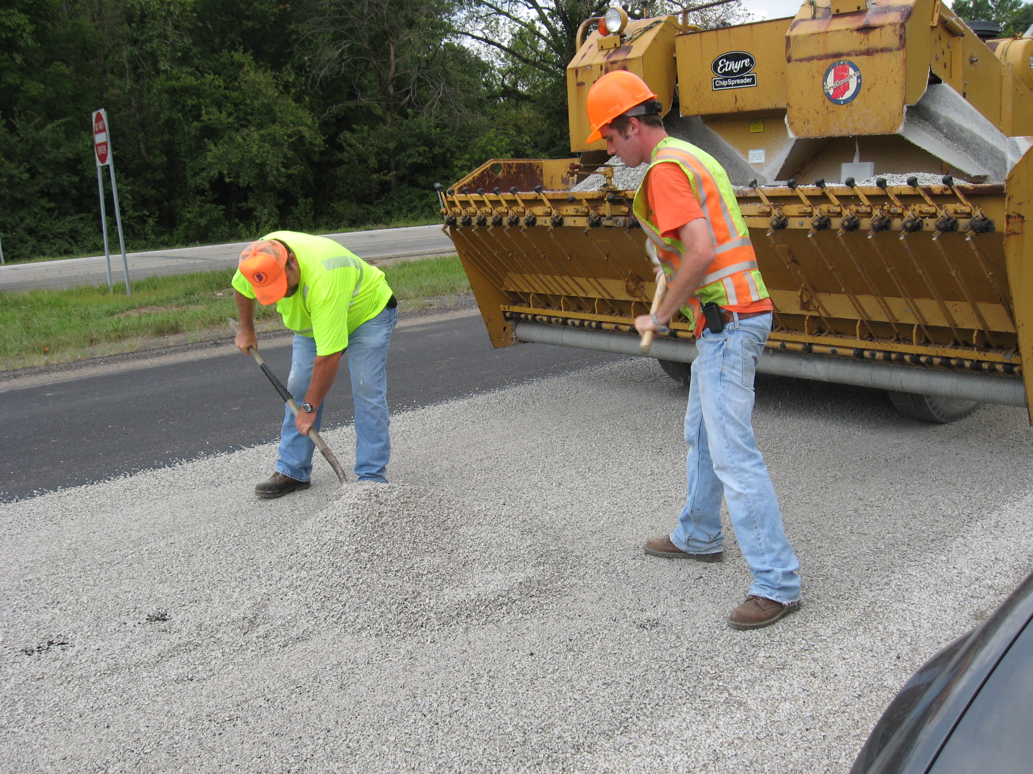
Critical Keys to Success
Conduct mix design
Notes:
Another Critical Key, conduct a mix design! In addition to what has already been mentioned in this section, I’ll give a few more reasons for design estimates:
When too much aggregate is used, the excess can break windshields and dislodge already embedded aggregates.
If too little aggregate is used, emulsified asphalt sticks to rollers that dislodge aggregate and/or flushing occurs.
The correct quantity of aggregate and emulsified asphalt should be determined prior to construction using the design procedures described in this section.

Slide 13
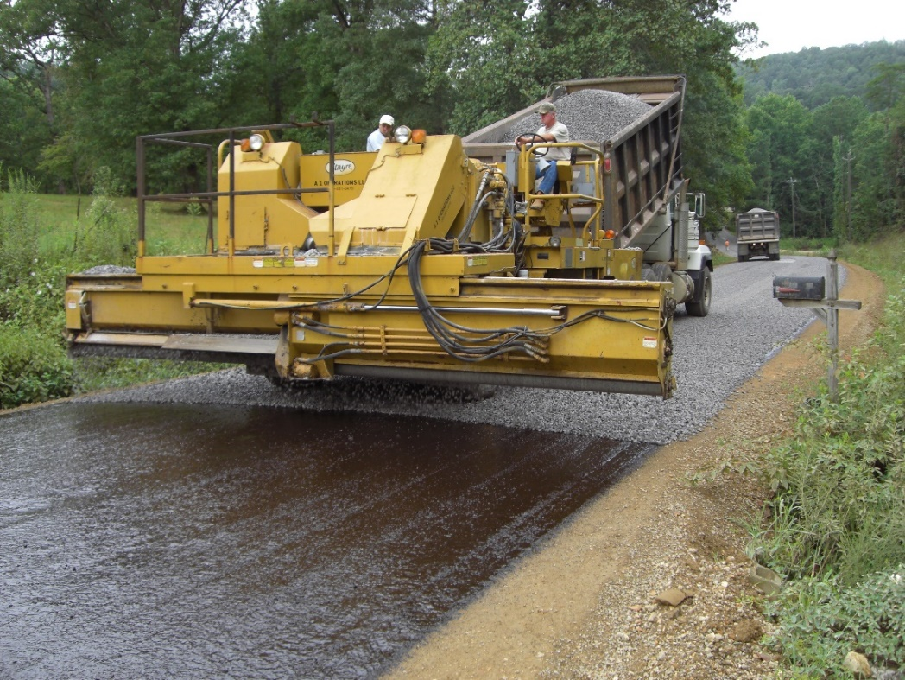
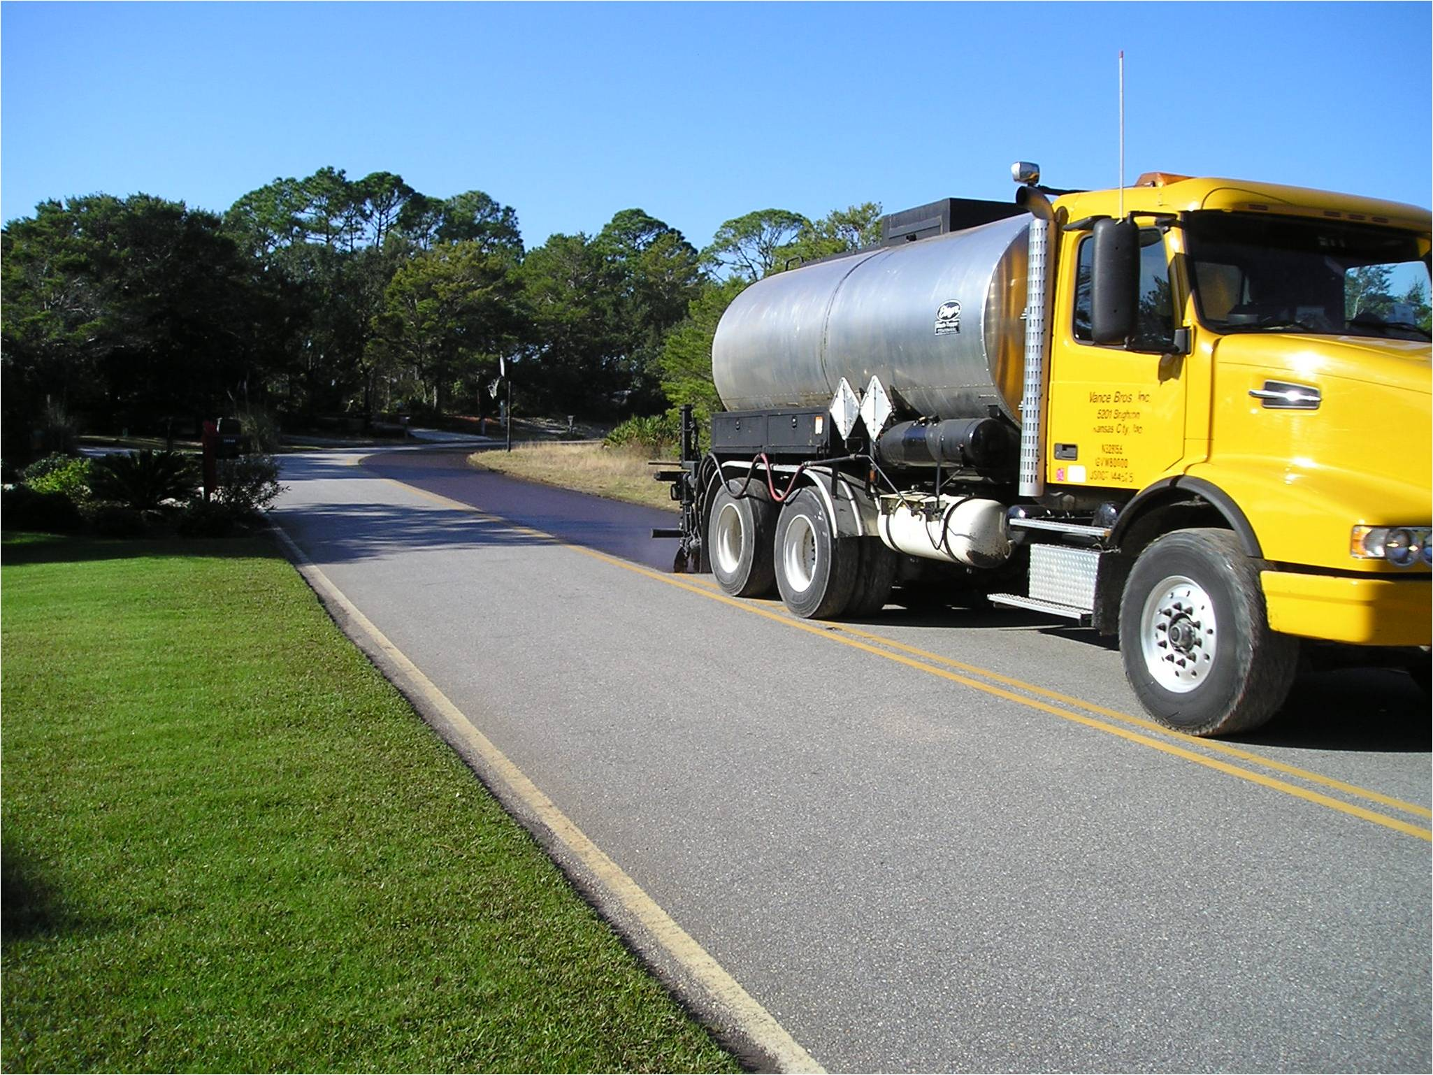
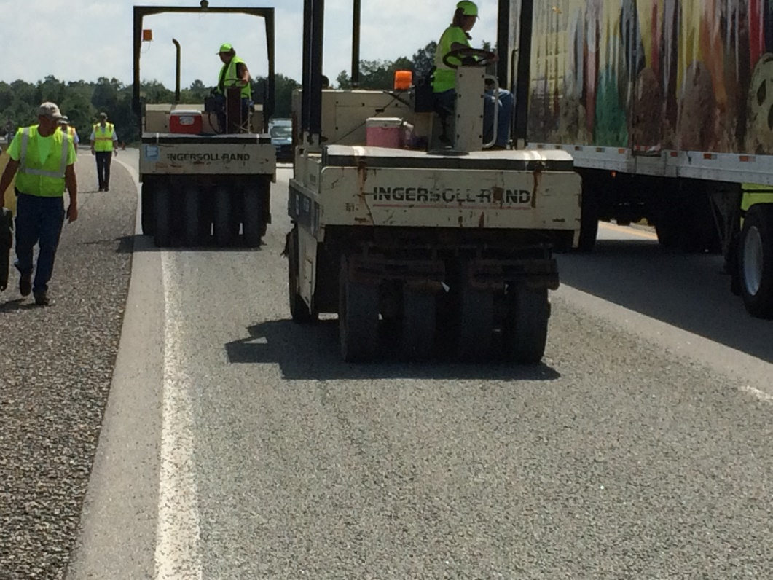
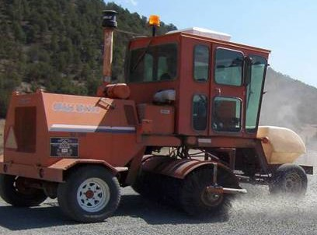
Equipment
Notes:
Next we are going to discuss the equipment used in the chip seal process. 4 of the pieces of equipment described in this construction guide are
Asphalt distributor
Aggregate spreader
Rollers
Brooms
Haul trucks

Slide 14
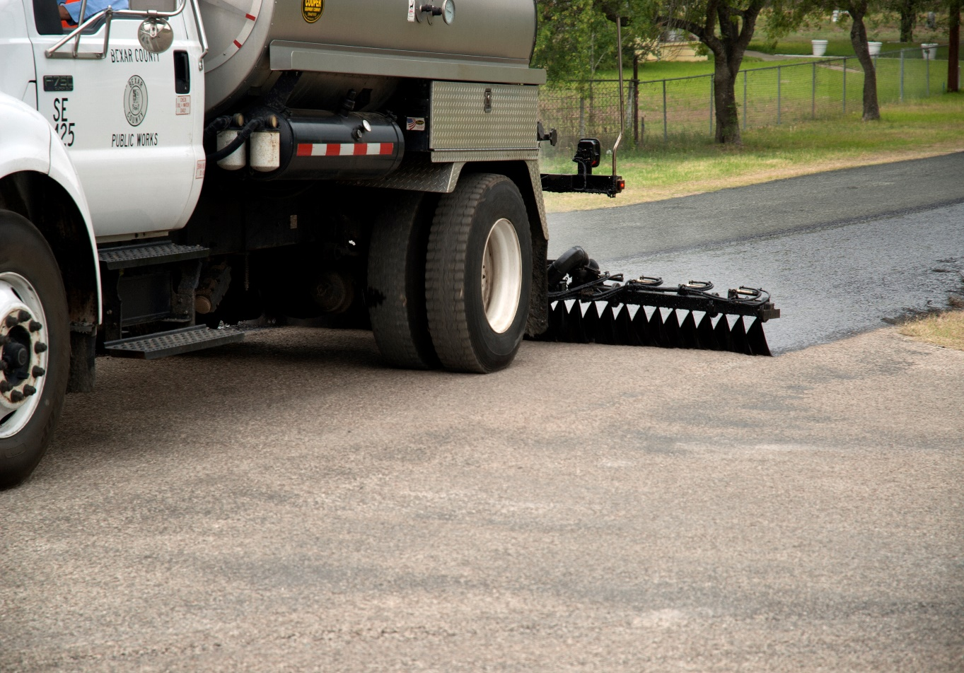
Asphalt Distributor
Applies emulsified asphalt to the
surface, it must:
  Be Calibrated
  Accurately control application rate
  Provide uniform coverage in both
  transverse and longitudinal directions
  Hold a specific temperature
  Have adjustable spray bar for double or triple overlap
  Have correct nozzles
Guidance is provided in section 406.5.2.1
Notes:
The first piece of equipment we will be talking about is the asphalt distributor. The asphalt distributor applies emulsified asphalt to the pavement surface as shown in the picture.
The distributor must be calibrated, accurately control application rate, provide uniform coverage, hold temperature, have adjustable spray for double or triple overlap coverage and have the correct nozzles.
The preferred method for coverage is triple overlap because it is generally more uniform.
Nozzles shall be positioned at 15-30 degrees.
The spray bar height should be checked to ensure you are getting the desired double or triple overlap coverage.
This will be approximately 12 inches.
A spray bar too high will create streaking with excess emulsion and a spray bar too high will create streaks with lack of emulsion.

Slide 15
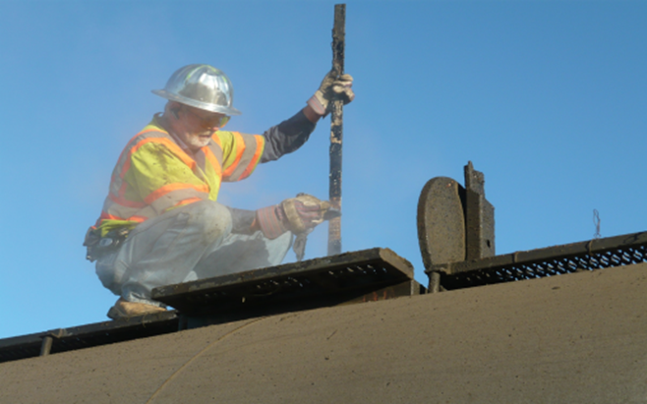
Asphalt Distributor
Determine quantity of emulsified asphalt in the truck.
Apply asphalt emulsion.
Determine ending volume.
Determine area covered.
Compare back to distributor computer.
Example
Calibrate distributor per the manufacturers and/or DOT recommendations
Notes:
Here is an example of Calibration, prior to shooting emulsified asphalt, take a volume reading with the dip stick.
Record this volume as ‘beginning volume’.
Set up the truck to shoot emulsified asphalt and shoot a minimum of 3000 feet by 12 feet of emulsified asphalt at the design rate using the gallon per minute pump flow volume and truck speed required by the manufacturer to attain this flow rate.
Take a second dip stick reading. Record this reading as ‘ending volume’.
Subtract ‘ending volume’ from ‘beginning volume’ and record this as ‘volume used’.
Determine the area of emulsified asphalt sprayed. Divide ‘volume used’ by the area sprayed in square yards.
This is the gallons per square yard applied to the pavement.
This value should then be compared to the asphalt distributor computer, if equipped, to evaluate the accuracy of the computer.
A correction factor may then be applied to the computer output, if needed, and used for the remainder of the day.

Slide 16
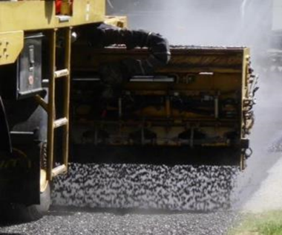
Aggregate Spreader
Spreads aggregate onto the
emulsified asphalt, it must:
  Be Calibrated
  Deliver the desired application rate
  using computerized controls
  Adjust to varying widths
  Distribute the aggregate uniformly in
  transverse and longitudinal directions
Spread rate Verification is covered in Section 406.5.2.2.2
.
Notes:
The aggregate spreader spreads aggregate onto the emulsified asphalt.
It must be calibrated, deliver the desired application rate, adjust to varying width and distribute the aggregate uniformly in transverse and longitudinal directions.

Slide 17
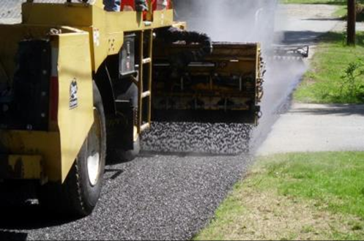
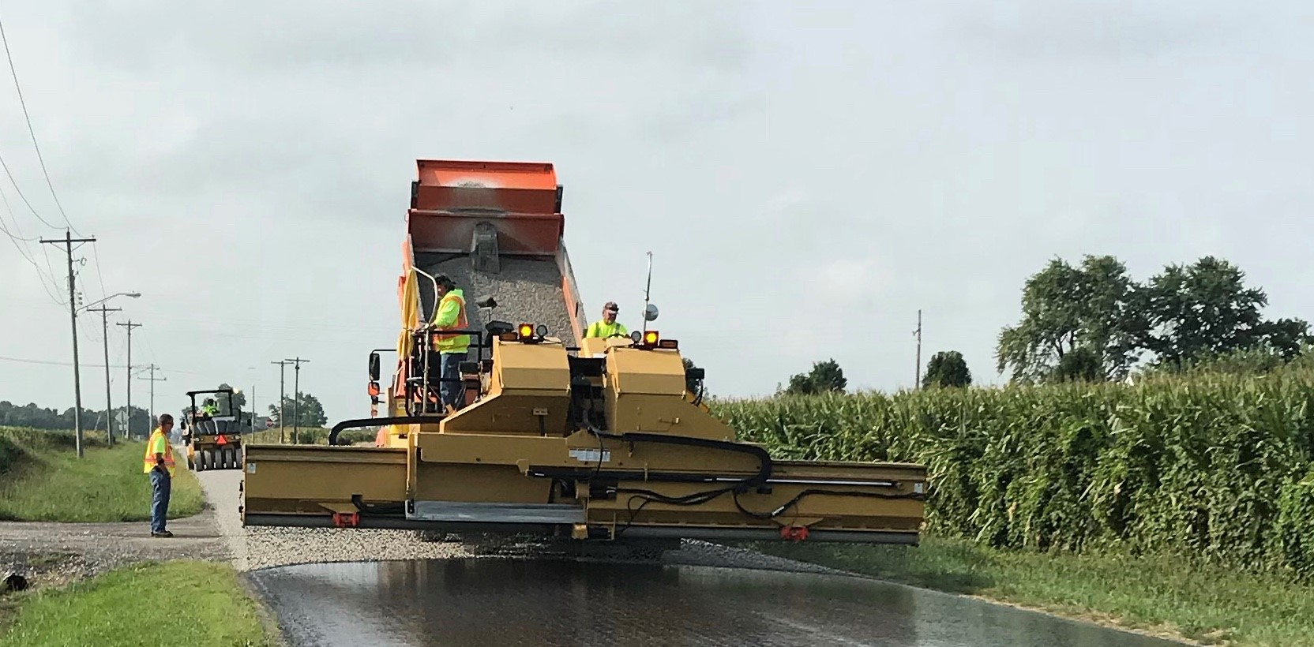
Aggregate Spreader
Calibrate distributor per the manufacturers and/or DOT recommendations
ASTM D5624 – measures quanitity of aggregate
Notes:
For calibration, a visual assessment of the lateral distribution of aggregate is a good place to start.
Any lack of light coming through the aggregate predator indicates an excess of aggregate.
Any excess light means a lack of chips.
Either instance means the machine should be stopped, the gates on the spreader contributing to the non uniformity adjusted and the trial rerun.
ASTM D5624 is a good procedure to use for measuring the amount of aggregate.

Slide 18
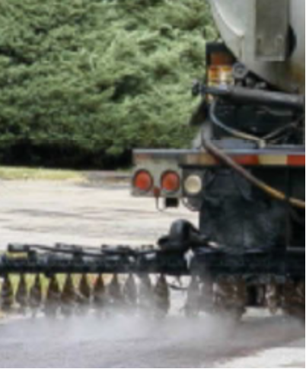
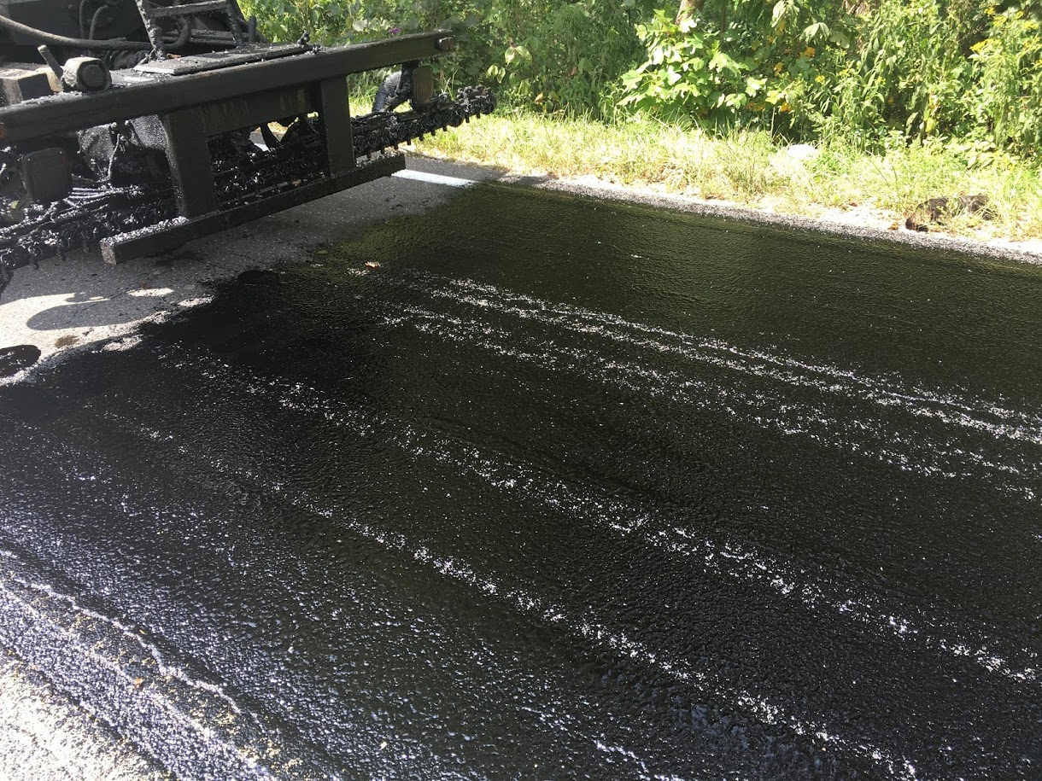
Critical Keys to Success
Perform Calibration
Notes:
This leads us to another Critical Key: Perform Calibrations!
Calibration is very important to assure the quantity of emulsified asphalt and aggregate applied to the pavement is correct.
Although many modern asphalt distributors and aggregate spreaders are computer controlled, calibration is required to tell the computer how much emulsified asphalt is being applied.
This quantity must be checked prior to spraying emulsified asphalt and spreading aggregates and checked against the quantity the computer(if so equipped) indicates is being applied.

Slide 19
Knowledge Check
When checking the spray bar for overlap, a lack of emulsion coverage between nozzles indicates?
Bar too low
Bar too high
Notes:
Bar too high

Slide 20
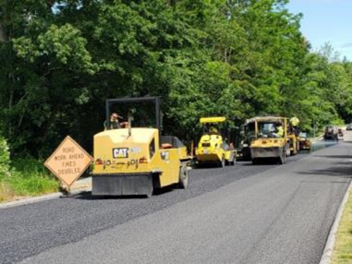
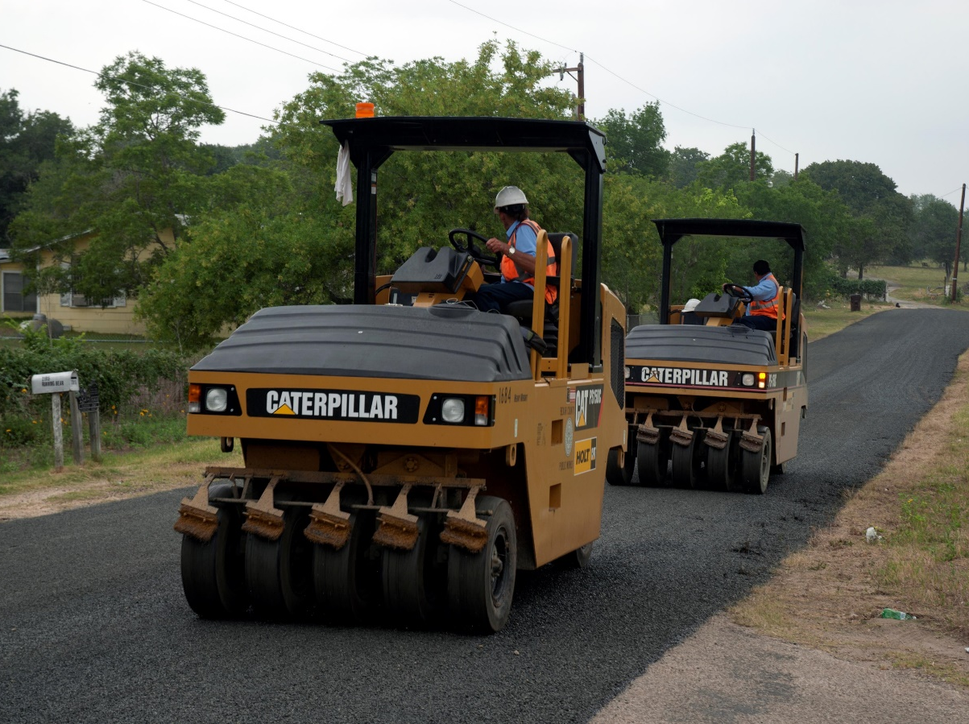
Pneumatic-Tire Rollers
Orients aggregate to the
flattest side, achieves embedment
A minimum of three
Capable of ballast loading
  Weight variable from 6 to 8 tons to achieve a minimum contact pressure of 80 lb/in²
Steel-wheel rollers have seen success when used as the final roller.
Guidance provided in Section 406.5.1.3
Notes:
Rollers, typically pneumatic tire rollers, are going to orient and embed the aggregate.
A minimum of three rollers is required and the rollers must be capable of ballast loading to allow the weight of the machine to be varied from 6 to 8 tons to achieve the 80lb contact pressure.
Rollers must be able to keep up with the aggregate spreader.
Steel wheel rollers have seen success when used as the final roller.
If choosing to use a steel wheel roller, ensure the aggregate can withstand the load.

Slide 21
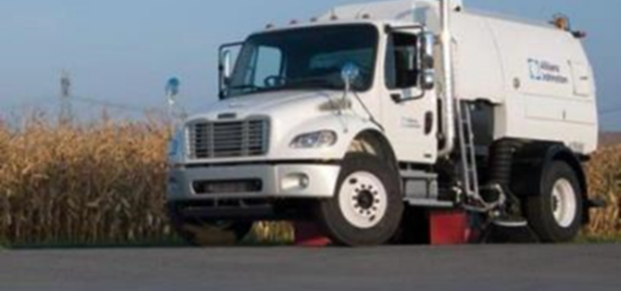
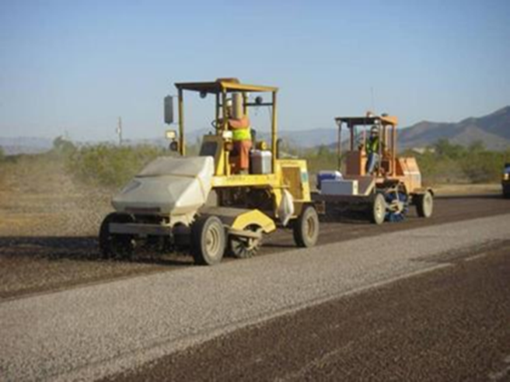
Brooms
Cleans the road surface before
emulsion is applied and after
aggregate is rolled
Motorized
Vertical pressure control
Plastic bristles
Guidance provided in section 406.5.5.7
Notes:
The next piece of equipment is the brooms. Brooms are used to clean the roadway prior to placing the chip seal and after the chip seal is rolled.
Brooms should be motorized, have vertical pressure control and plastic bristles.
Depending on the location of the road being treated, the brooms can be vacuum or rotary.
Before applying the treatment the road surface should be cleaned 30 minutes prior.
Time to sweep after the chip seal will be discussed later in this presentation.

Slide 22
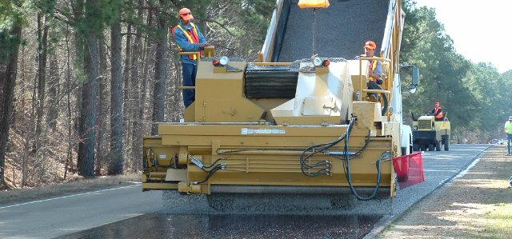
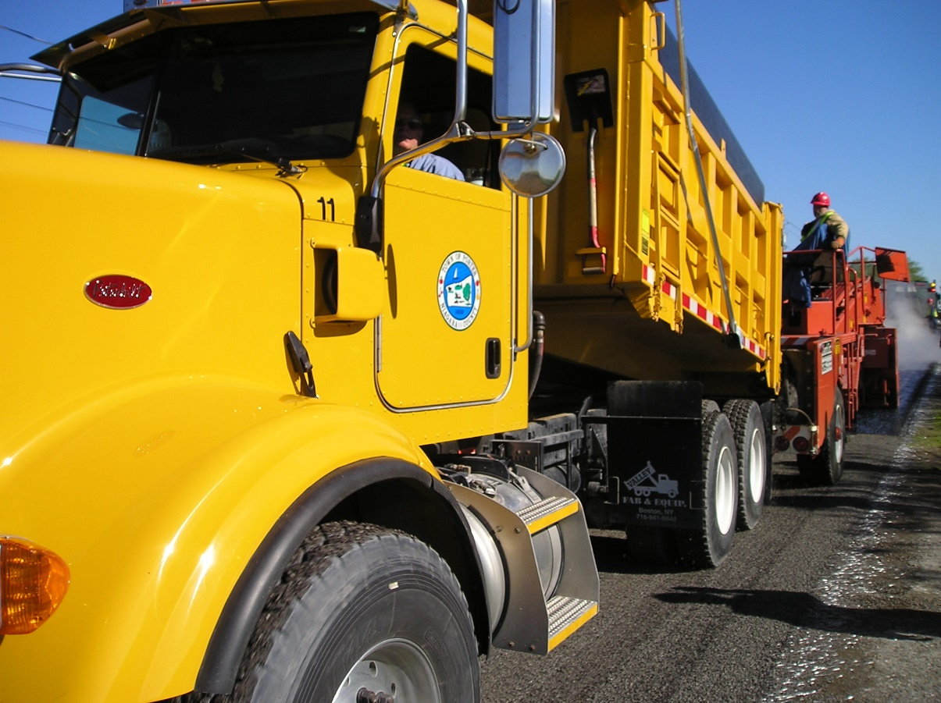
Haul Trucks
Hauls aggregate to the spreader
Use trucks of uniform capacity.
Provide documentation showing measurements and calculation in cubic yards.
Clearly mark the calibrated level.
Notes:
The last piece of equipment we will talk about are haul trucks which are used to haul the aggregate to the spreader.
Trucks must be of uniform capacity.
Documentation should be provided showing measurements and calculation in cubic yards and the calibrated level should be marked.
The trucks should be staggered as they approach the spreader and enough trucks should be in service to minimize stopping of the spreader.

Slide 23
Knowledge Check
Should 3 steel wheel rollers be used in place of rubber tire rollers?
True
False
Notes:
False, If a steel wheel roller is used, it should only be used in the final pass and limited to 5 tons.

Slide 24
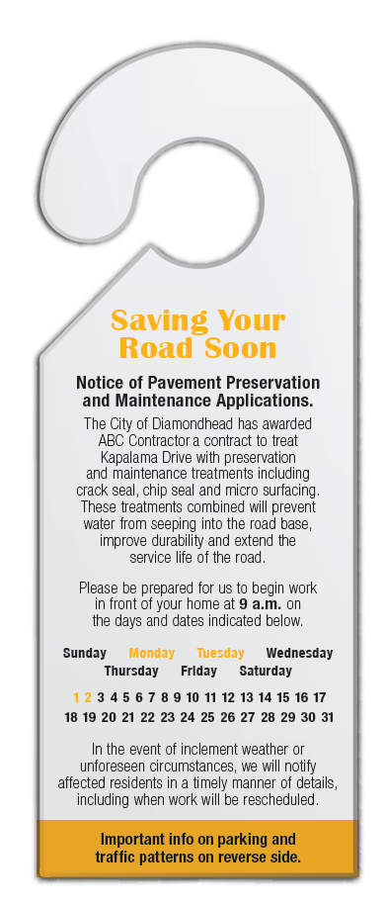
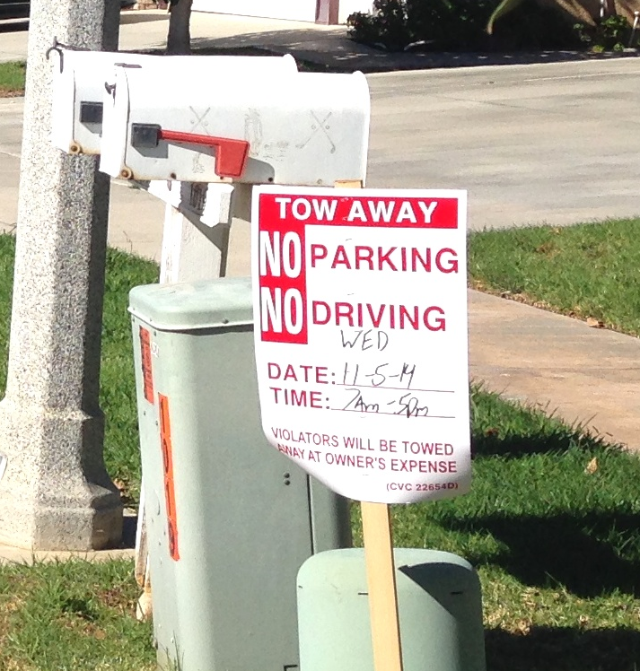
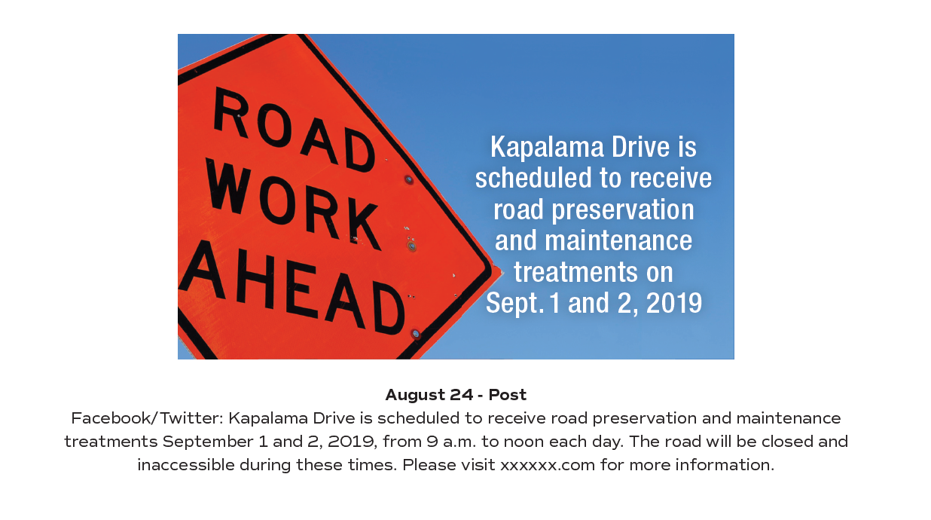
Construction – Public Notification
Notes:
Notifying the public of the upcoming preservation treatment can start a few weeks before project start up and can be done by the agency.
Flyers, social media and agency websites are all good places to post this information.
The final notification can be done by the contractor and should include a 24 hour notice delivered door to door for those affected.
Thorough notification can really help minimize issues with an uninformed public.

Slide 25
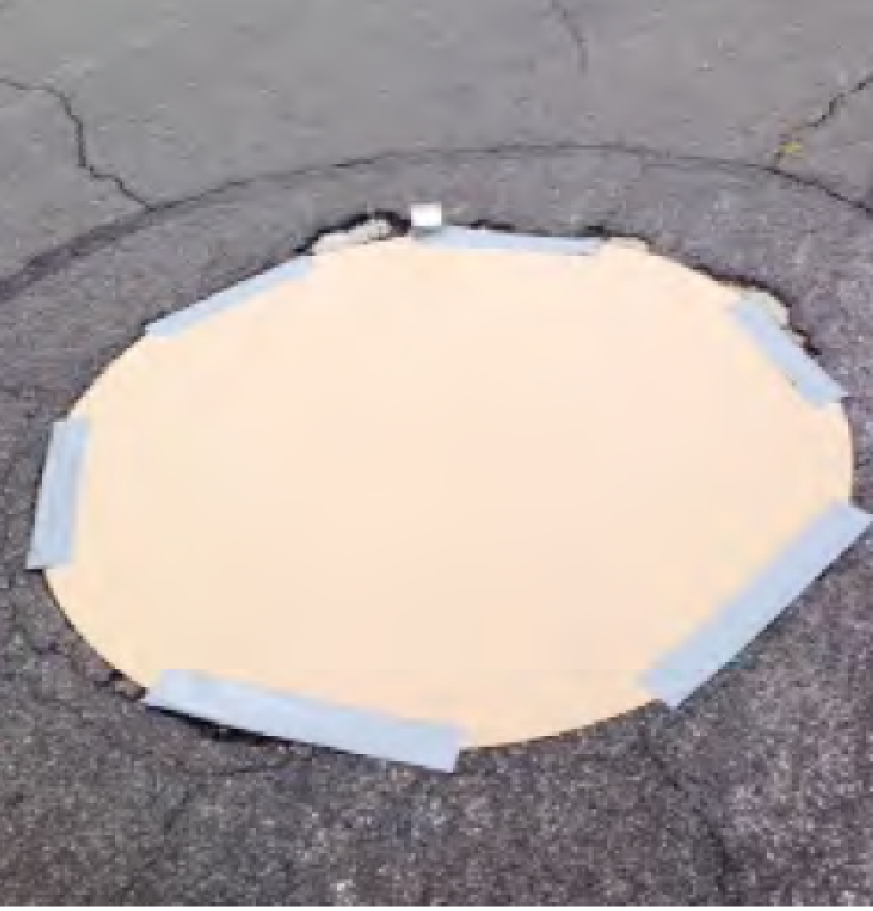
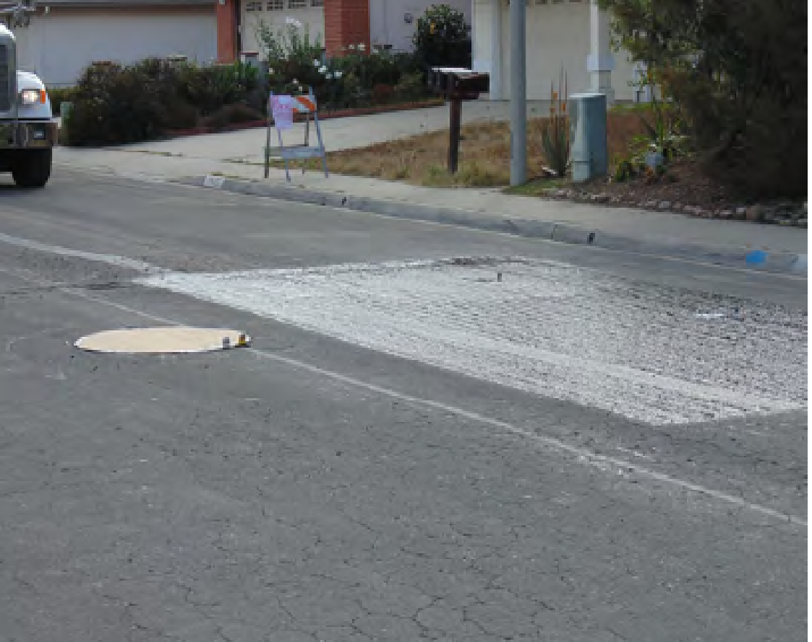
Preconstruction
Preconstruction meeting
Clean Roadway
Protect Accessories
Stripe Removal
Notes:
Before beginning any work, a preconstruction meeting should be held.
Some topics should be construction process, quality control plans, traffic control plan, and equipment/process overview just to name a few.
Roadway should be cleaned, not more than 30 minutes prior to beginning work.
Accessories need to be protected with plywood disks, roofing felt or Kraft paper. T
hermoplastic stripe must be removed. Others can be left in place. The agency should evaluate the costs/benefits before removing.

Slide 26
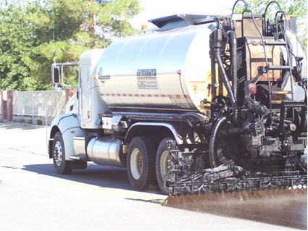
Construction
Test Strip
  Similar project placement conditions:
    Time of day
    Temperature
    Humidity
Notes:
Moving on to the test strip. This should be conducted on or near the project site.
You want to put this down under similar placement conditions: time of day, weather, temperature and humidity.
The same job mix proportions, materials and equipment should be used.
The agency can evaluate the strip to determine if project specifications are met.
If not, additional test strips should be conducted.

Slide 27

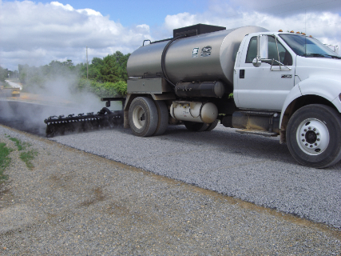
Construction
Weather
  50°F and rising
  During daylight hours
  Suspend when pavement exceeds 140°F
  Surface shall be dry to damp
Notes:
Continued…
Weather conditions have a signification role in the construction process
Ambient and pavement surface temperatures shall be 50°F and rising. Check shaded areas.
Application of the chip seal shall be only during daylight hours.
Suspend chip sealing if the pavement surface temperature exceeds 140°F.
The road surface shall be dry to damp.

Slide 28
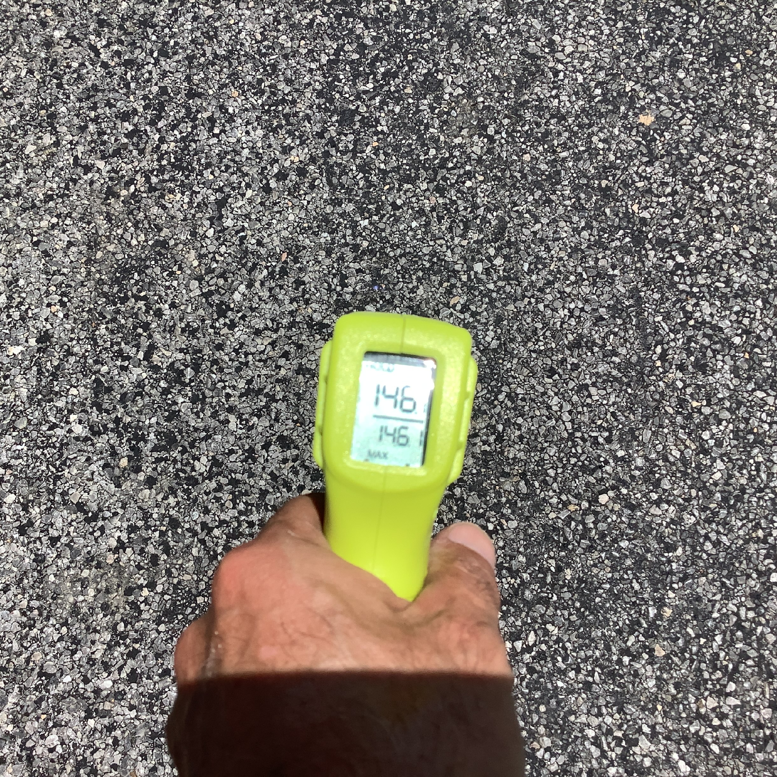
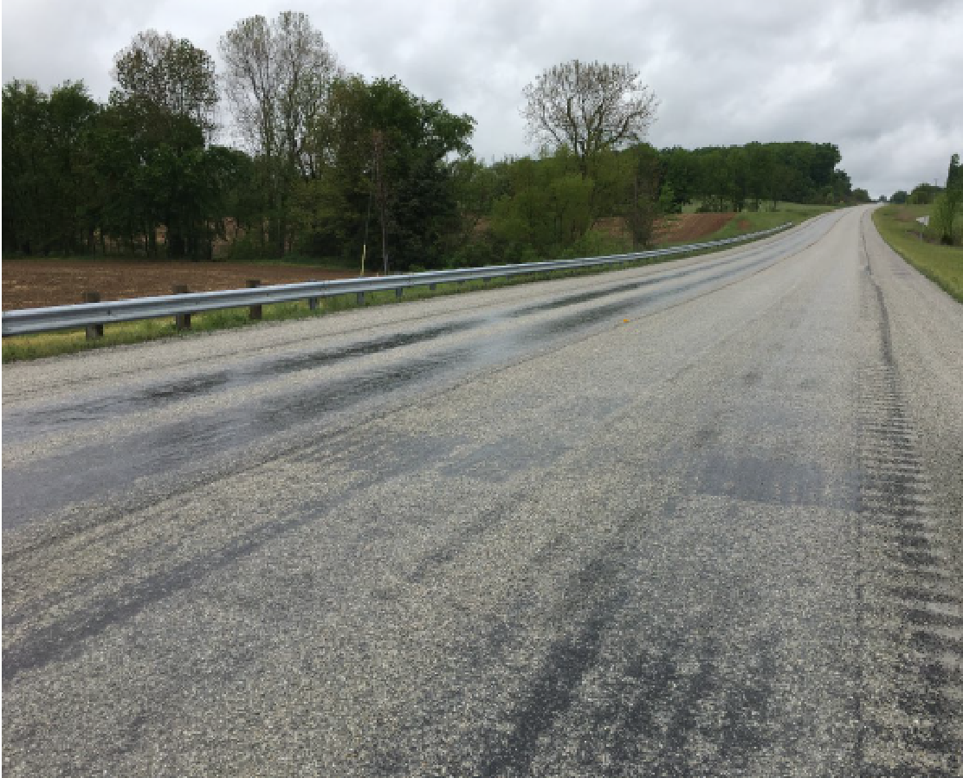
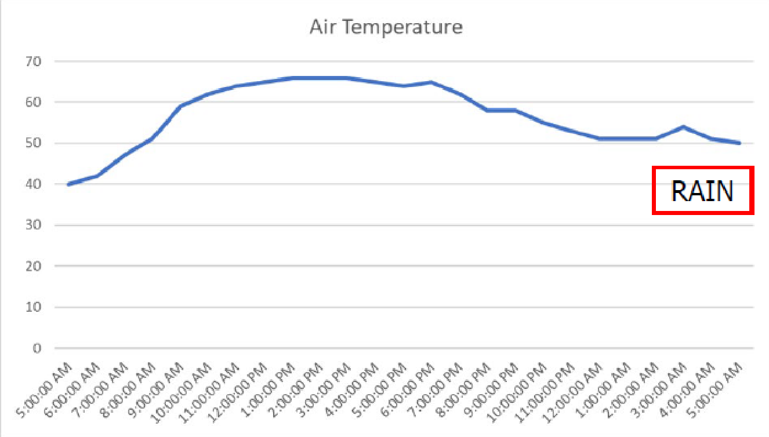
Critical Keys to Success
Weather requirements are met
Notes:
This leads us to another critical key! Weather requirements must be met.
And, not just the day of. You have to look further out.
I have an example here from a chip seal conducted in Indiana. Indiana has a fantastic chip seal program. On this particular day, crews waited until temperature conditions were met before starting work and everything looked great the day of, but by the following morning, it was raining which led to significant aggregate loss and the road had to be milled. Always, always check the weather outlook and know when to STOP.

Slide 29
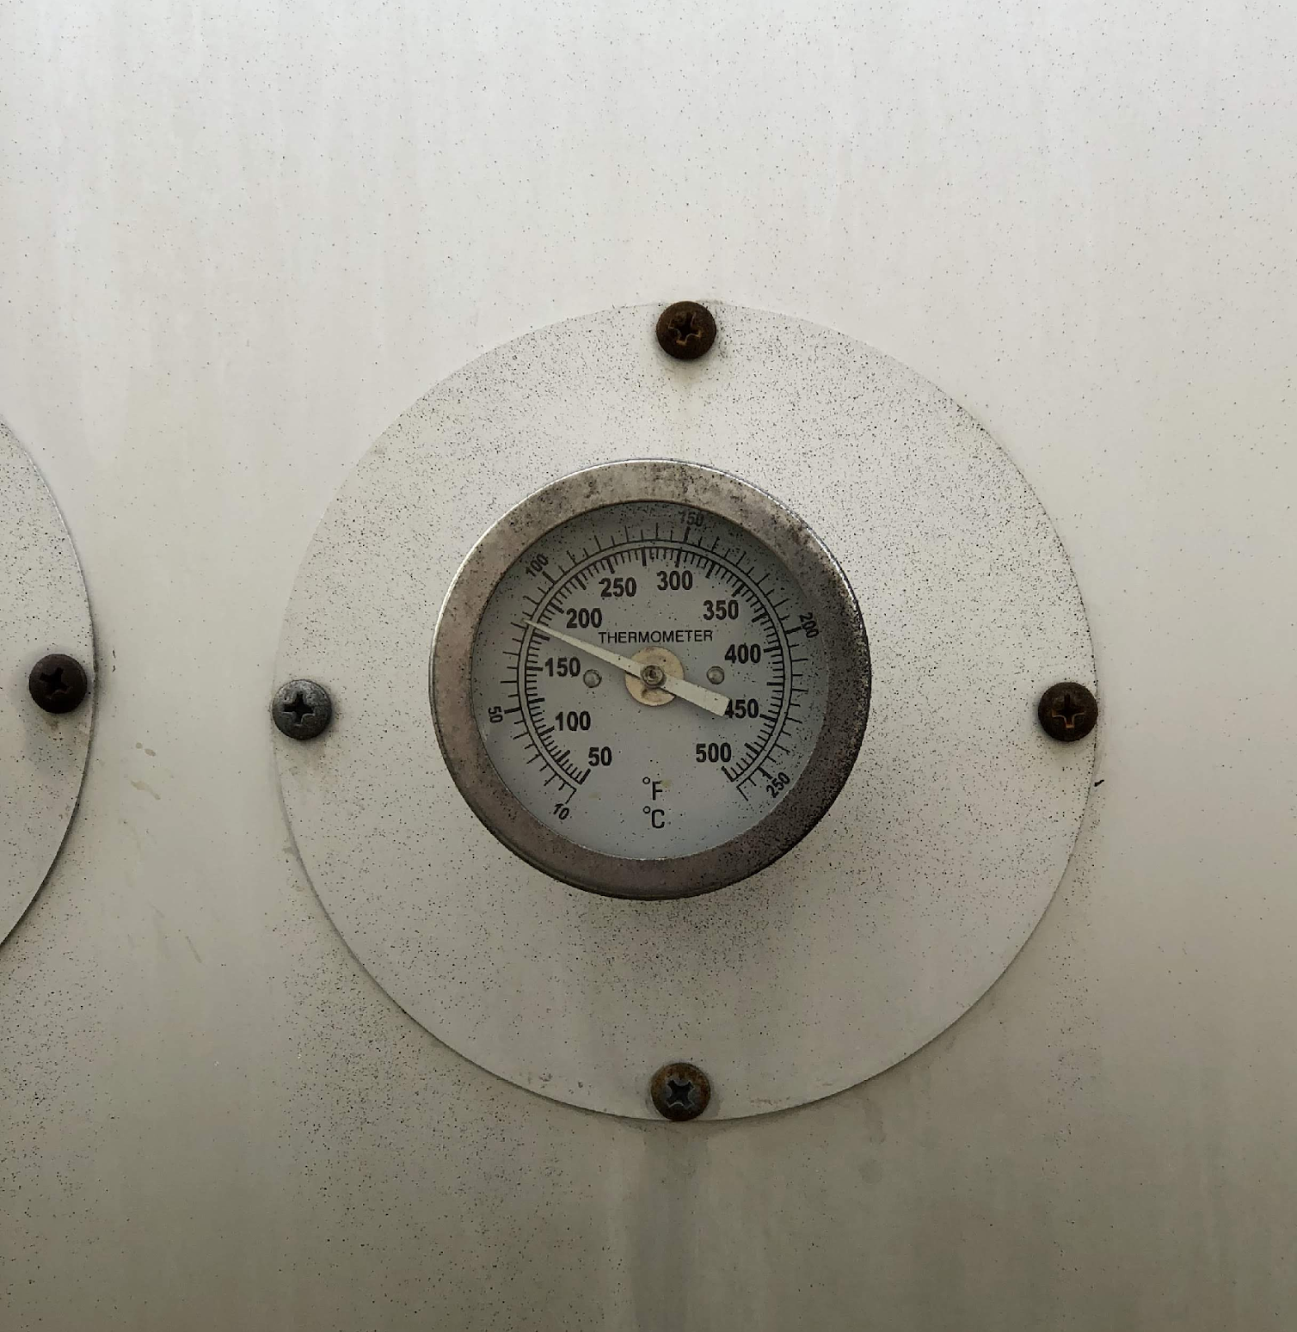
Construction
Emulsion Application
  Emulsion placed within +/-5% of the design rate
  Some emulsion should be visible through the chips (salt and pepper look)
  Emulsion should not be sticking to the tire rollers
  Temperature of emulsion shall be above 120°F
Notes:
For emulsion application, the emulsion should be placed within +/- 5% of the design rate.
Once the cover aggregate is placed, some emulsion should be visible through the aggregate, but not so much that it is sticking to the tire rollers.
In either of these instances, application rates should be adjusted.
To avoid any high viscosity issues, emulsion should be at least 120F at the time of application.

Slide 30
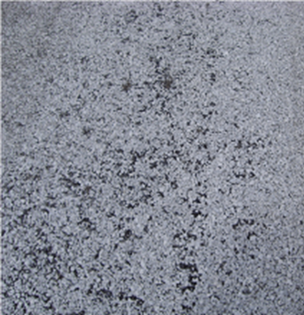
Construction
Aggregate Application
  Aggregate shall be damp, but surface dry
  Damp aggregate draws emulsion into the aggregate pores
  Shall be similar to design rate but adjustments are almost always necessary in the field
Notes:
Continued…
Aggregate application
*Shall be damp
*Damp aggregate draws emulsion to pores
*Shall be similar to design rate but adjustments are allowed if necessary
If all emulsified asphalt is covered, there is an excess of chips.
Starting and stopping of the spreader should be minimized along with any spillage during filling of the spreader.

Slide 31
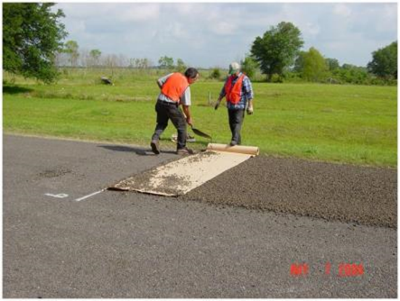
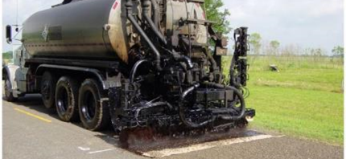
Construction
Transverse Joints - A roofing felt or heavy construction paper joint shall be used so excess asphalt and chips are not placed at the joint.
Notes:
When we do have to stop and start, creating a nice looking transverse joint is important.
This should be accomplished on top of heavy kraft paper, or roofing felt.
The asphalt distributor should stop spraying once the spray bar passes the start of the paper.
This is also true for the aggregate spreader. When starting back up, the distributor should start spraying at the back of the paper.
This practice will keep excess aggregate and asphalt emulsion from being applied at the joints.

Slide 32
Construction
Rolling
  First pass of rollers must be within 2 minutes of applying aggregate.
  Roller speed, 3MPH or less
  Three complete passes
  Position rollers so entire width of chip sealed surface is covered
  If desired, a steel wheel roller can be used for final pass
Notes:
Rolling
First pass of the rollers shall be within 2 minutes of applying the aggregate. The rollers should be moving < or equal to 3mph. You want to complete three passes and make sure the entire width of the chip seal is covered. Also, as noted previously a steel wheel roller has seen some success when used as the final roller.

Slide 33
Construction
Sweeping
  Verify sequence
  Ensure 85% moisture has evaporated
  Aggregate removal should be less than 10%
Chip Seal Classª
I < 500 AADT | II 501-5000 AADT | III > 5000 AADT
Within 24 hours after rolling | No later than the following morning | Before traffic is allowed without traffic control
Construction Guide Specification ,Table 1, p.12 – Sweeping Sequence
Notes:
The sequence/timing of sweeping should be verified with the engineer.
The table here shall be used to determine when sweeping must occur.
In addition, There is a test method in NCHRP 680 that can tell you the moisture content of your chip seal.
You want to wait to sweep until 85% of the moisture has evaporated.
If more than 10% of the aggregate is being removed, the application rate should be reduced.
As noted in the brooming section, brooms may be rotary or vacuum, with vacuum sometimes being the preference in urban areas.

Slide 34
Construction
Traffic on a fresh chip seal shall be controlled by the following:
Chip Seal Classª
I <500 AADT | II 501-5000 AADT | III >5000 AADT
Traffic controlled with speed limit signs | Traffic controlled with pilot cars | Traffic controlled with pilot cars
Notes:
Traffic control after placement of the chip seal should follow this table.
The classes of Chip seal are based on Average Annual Daily Traffic.
As you can see, traffic is controlled with either speed limit signs or pilot cars.
Pilot cars should be used until the roadway and shoulders have been swept free of aggregate.

Slide 35
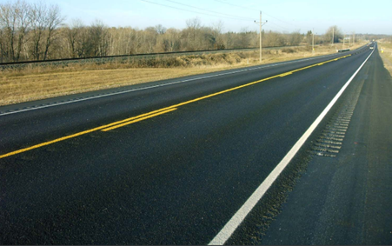
Construction
Fog Seal – The chip seal shall be allowed to cure a minimum of 24 hours before placement off a fog seal.
Notes:
What a way to make a chip seal really look nice, but it has other benefits as well: creates a sharper contrast for pavement markings, improving visibility and the light application of asphalt binder aids in chip retention.
One important thing to remember when applying the fog seal is you want to wait a minimum of 24 hours after placement of the chip seal and after the surface has been swept.
Early application can lead to locking in moisture.

Slide 36



Measurement/Payment
Measurement
  Emulsion – by volume at 60°F
  Aggregate – by area of pavement surfaced
Payment
Unit costs or total area covered
  Unit cost – Emulsion(gal), Aggregate(tons), Fog seal(gal)
  Total area covered – Chip seal(yd²)
JESHOOTS.com
Notes:
Measurement and payment is also included in the construction guide.
Measurement of emulsion is made at 60F and aggregate by area of pavement surface.
Payment can be made in two ways, either or unit costs of emulsion, both chip seal and fog seal in gallons and aggregate in tons or total area covered chip seal yd’s squared.

Slide 37

Knowledge Check
Fog seals just paint the surface black?
True
False
Notes:
False. Fog seals also help with visibility and chip retention.

Slide 38

Important Points to Understand
Aggregate Dust
Cure Time
Rounded Aggregate
Roller Passes
Spray Rate
Notes:
These last few slides along with the critical keys that have been scattered throughout the presentation are some of the important takeaways from the construction and QA guides.
Aggregate Dust - Aggregate Dust above the limits inhibits bond between the chips and the asphalt emulsion.
Cure time - slower setting emulsions take much longer to cure thus sweeping and traffic must be delayed. Rapid setting is always the first choice.
Rounded aggregate - rounded aggregate is more susceptible to rolling and displacement by traffic.
Roller passes - First roller pass within two minutes and limit roller speed to maximum 3 mph.
Emulsified Asphalt Spray rate - this must be a calibrated and verified number.

Slide 39
Important Points to Understand
Aggregate Spread Rate
Aggregate Gradations
Quick checks of Application Rates
Ambient and Pavement Temperatures
Notes:
A few more here. Aggregate spread rate - This must be a calibrated and verified amount, can be verified by checking truck weight and dividing by the area covered.
Aggregate gradations - Gradations should be checked from both the stockpile and the hopper to ensure the aggregate quality is on specification.
Application rate checks - Quick check so application rates (volume of emulsion/area & weight of aggregate/are) are recommended - 4X daily.
Ambient and pavement temperatures and just weather in general - these need to meet the specifications listed in the guide for the day of and for the days proceeding.

Slide 40
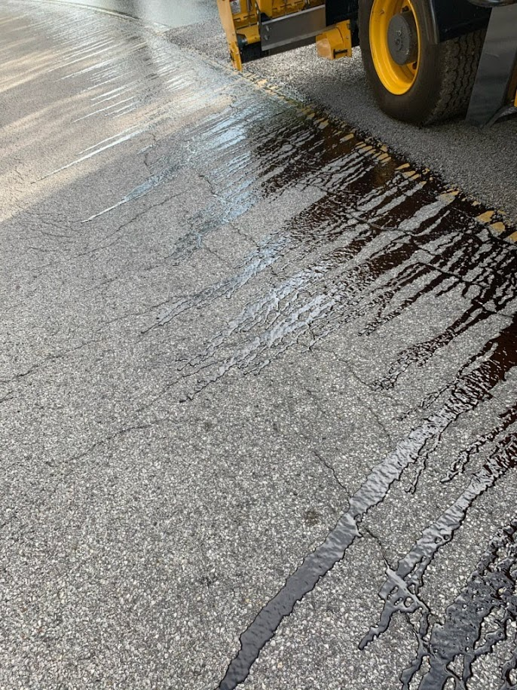
Critical Keys to Success
Incorporate a QA/QC program
Notes:
*Incorporate a QA/QC program into specification. Without quality you have nothing.
*Quality assurance guides are developed for slurry and chip seal.
*The guide includes:
Contractor Quality Control
Agency Acceptance Protocols
Independent Assurance

Slide 41
Quality Control
Personnel –
  QC Manager – responsible for development and implementation of the Quality Control Plan
  QC Technicians – responsible for sampling and executing QCP
  Certified Crew Members
Testing Facilities and Equipment
  Lab for testing of both emulsions and aggregates
Notes:
You get what you test/inspect NOT what you EXPECT
Stress importance of testing

Slide 42
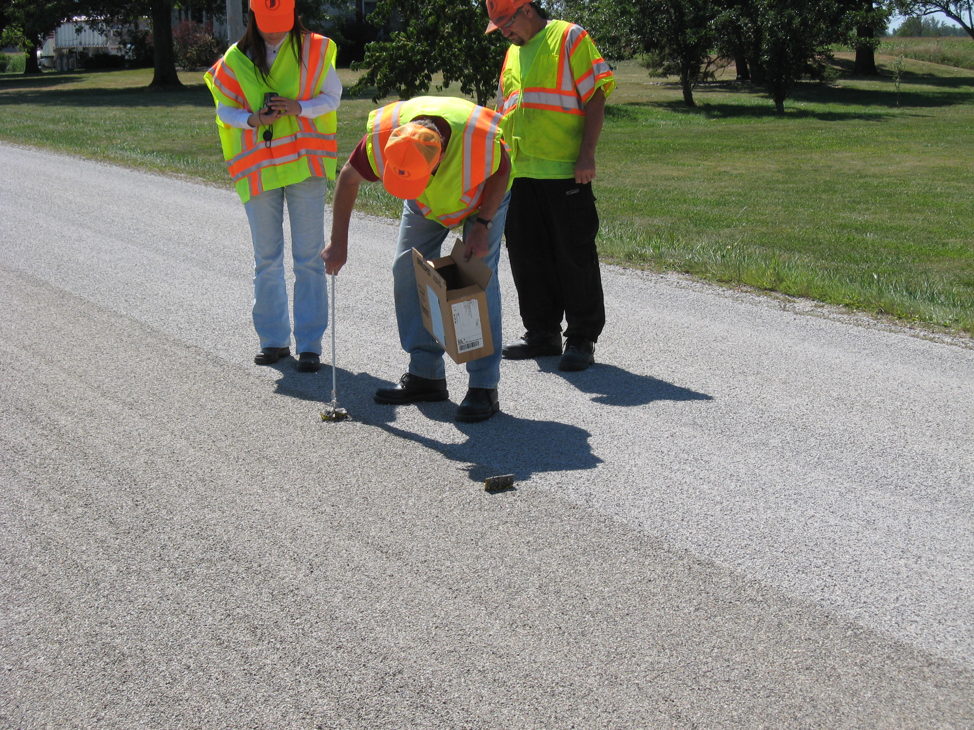
Critical Keys to Success
Trained (certified) inspector & contractor staff
Nationally recognized certification
Agency certification
In-house training
Successful projects have well trained staff
Notes:
*It is important to have trained or certified inspectors and construction staff to ensure that quality work is being completed.
*They need to know the state specs and equipment requirements.
*They need to know what good and bad work looks like.
*They need to know the specs on the materials as they review certificates of analyses showing up on the job.

Slide 43
Thank You
Questions?
Notes:
I hope this is encouraging to go out and use the newly developed construction guide. If you want any assistance implementing this spec into your existing spec, need any training or are interested in doing a demo following these guides for a treatment you have planned for this year or the following year, please reach out and I can help or I can put you in touch with someone else from our group that can.

Slide 44













Resources
This is the suggested color palette for the template.
This image was downloaded from a free use graphics website.
This image was downloaded from a free use graphics website.
This image was made by Travis and is free to use.
These icons were downloaded from a free use graphics website and slightly altered.

